Slide 1
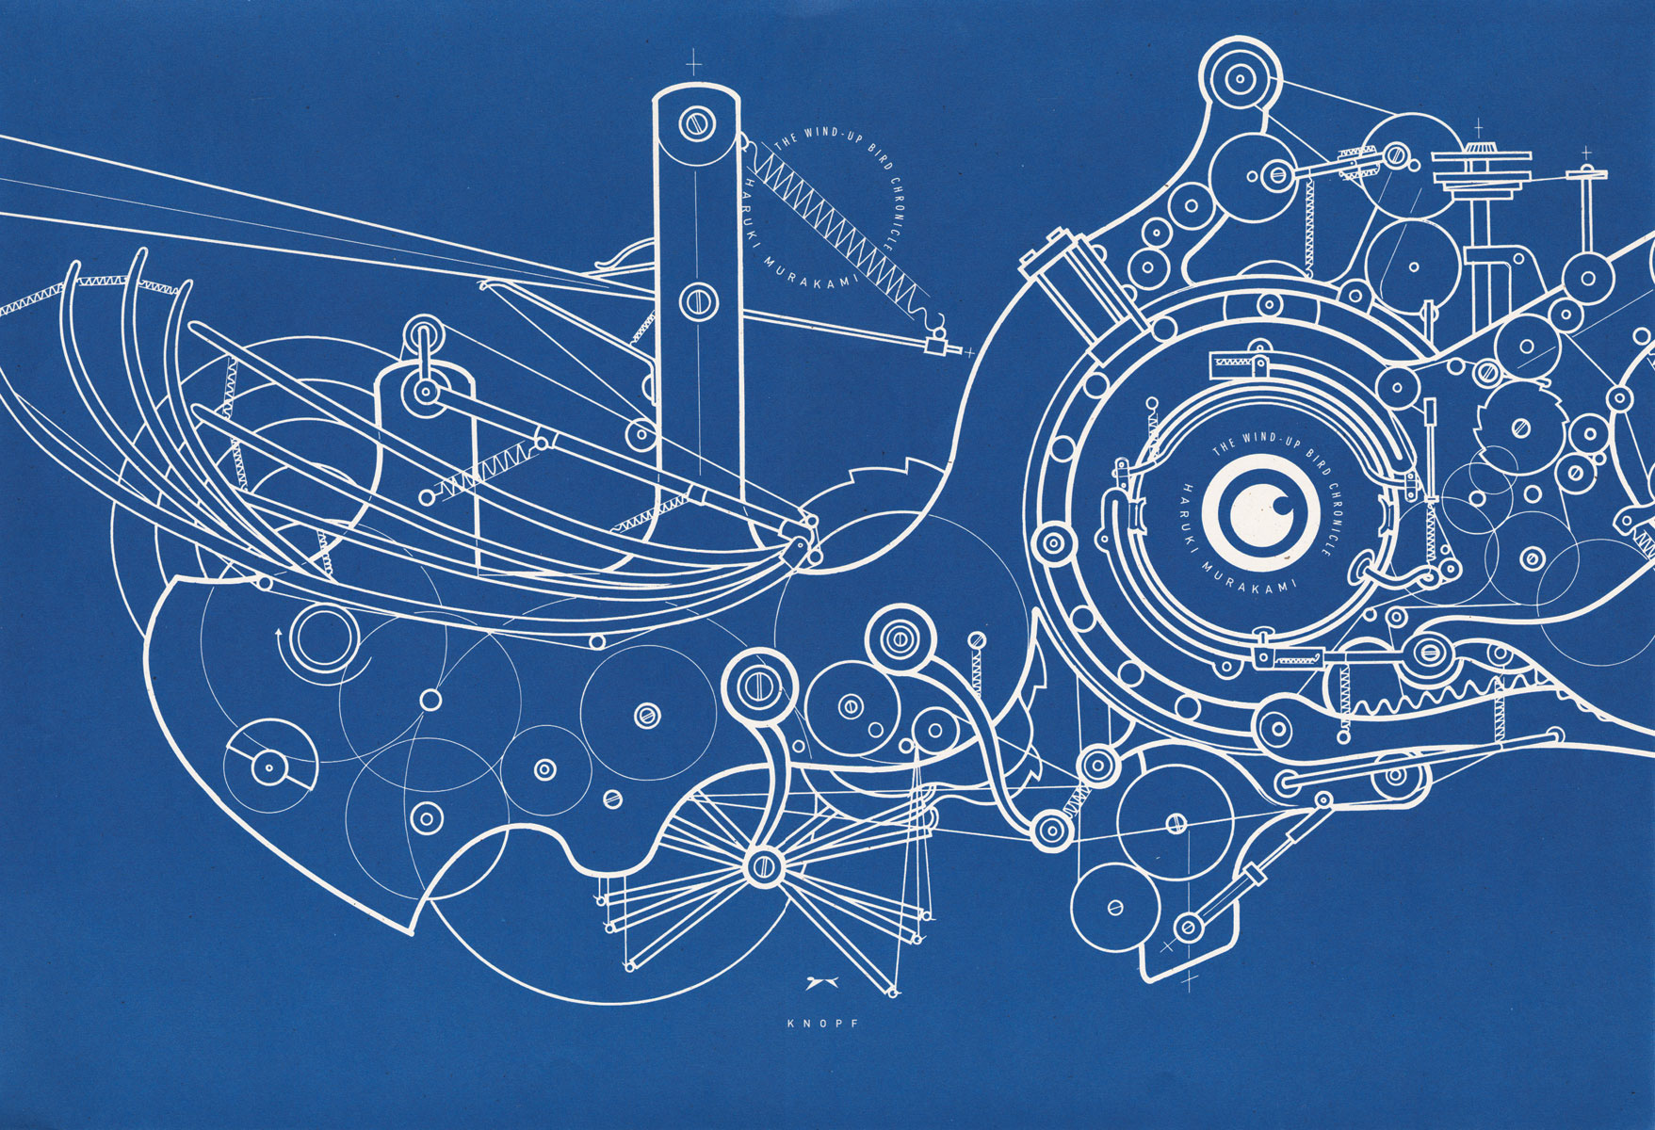
Medicine and technology
- stories from the history of medicine
Adam Bencard
Associate Professor
Medical Museion/CBMR
University of Copenhagen

Slide 2
Medical humanities
The medical humanities ask big questions about how health, illness, medicine, and the body are understood, and with what effects
Medical humanities research often involves situating clinical or technical practice in a broad cultural, historical, and experiential context
A contextual view of medicine and technology – tracking culture into the hardware and back again

Slide 3
Medical humanities
We imagine as well as construct our world through tools and machines (technology as world-building)
This also means that technology often fades from view
“Objects are important not because they are evident and physically constrain or enable, but precisely because we do not ‘see’ them. The less we are aware of them, the more powerfully they can determine our expectations by setting the scene and ensuring normative behaviour, without being open to challenge. They determine what takes place to the extent that we are unconscious of their ability to do so” (Daniel Miller, Materiality, 2005, 7)

Slide 4
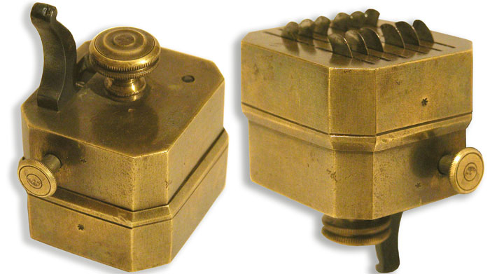

Slide 5
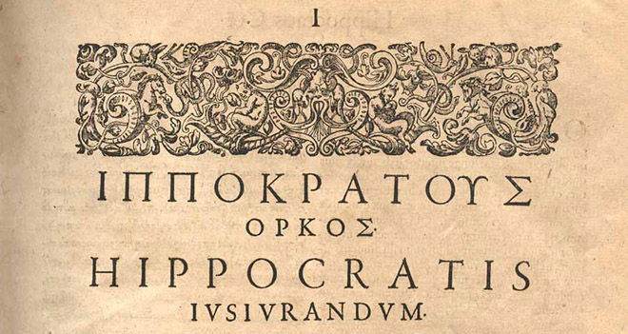
Bloodletting
The body is a balance system – a cosmic system with a golden rule
The humours – quality and quantity together
“Blood, phlegm, yellow bile and black bile are the particular elements of the nature of man ... And it is quite clear that each of them comes from the four primary elements which we call wetness, dryness, cold and heat, naming them after their qualities; the specific terms fire, water, air, and earth are from their substance.” (On the Nature of Man)

Slide 6
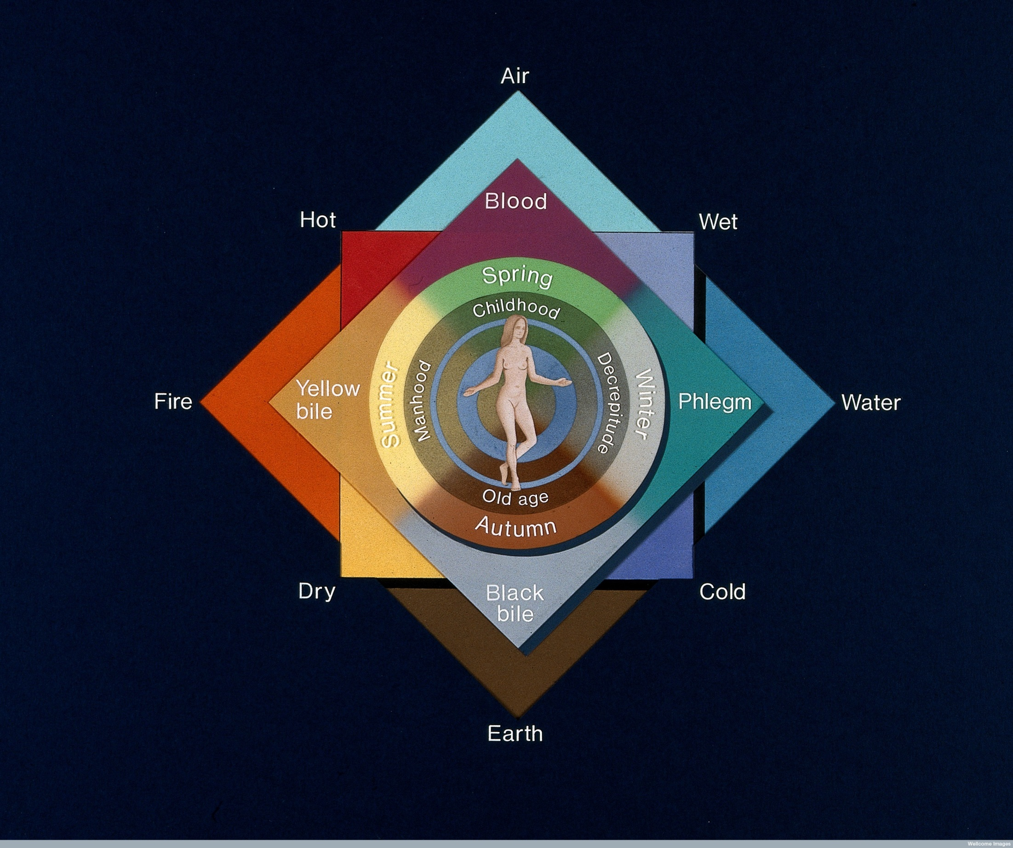

Slide 7
Bloodletting
“Furthermore, one must know that diseases due to repletion are cured by evacuation, and those due to evacuation are cured by repletion; those due to exercise are cured by rest, and those due to idleness are cured by exercise.“
(Galen - Om Menneskets Natur)
The art was knowing how much and when – it depended on the patient, the season, lifestyle, climate, etc
Galen (129-ca. 200): In serious cases, two daily bleedings – the first stopped before the patient fainted, the second until fainting

Slide 8

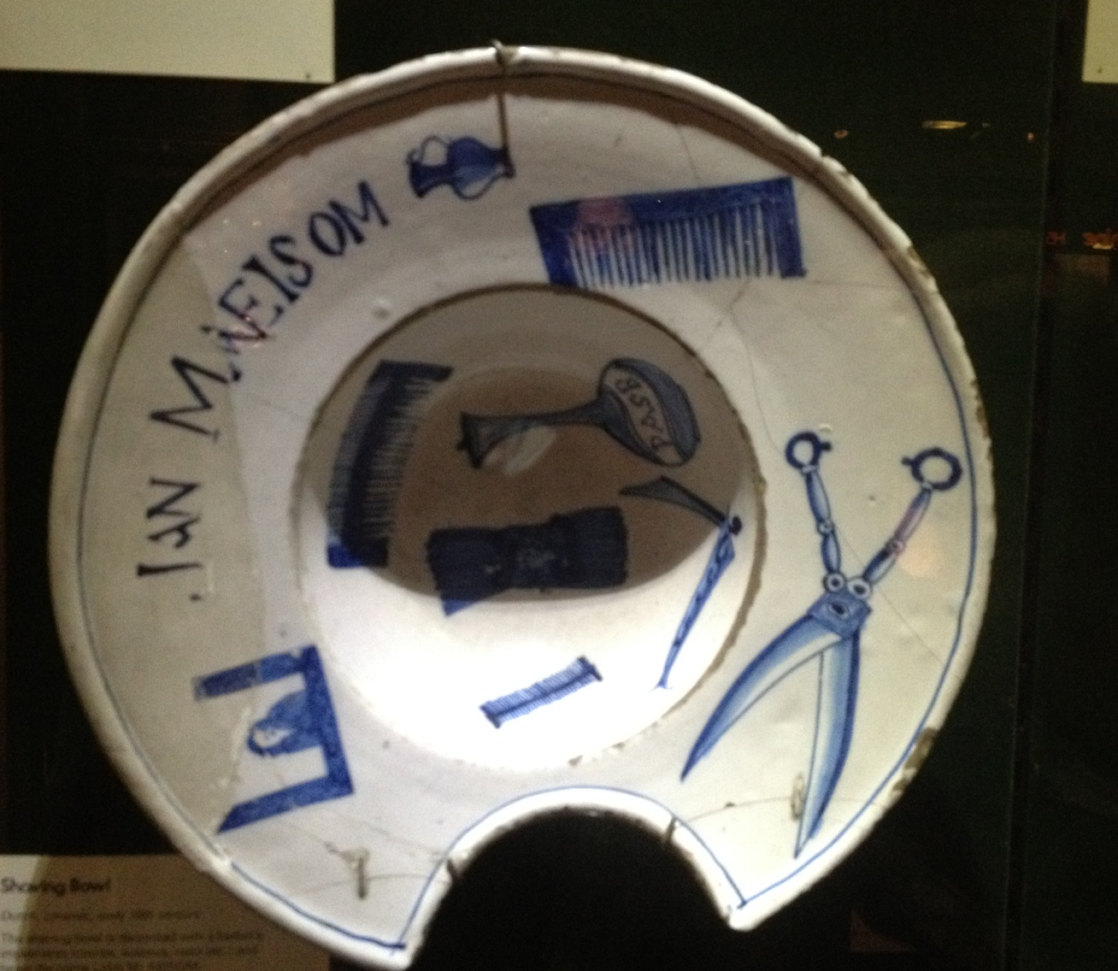
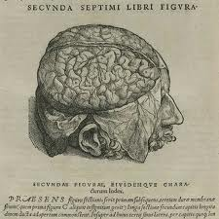
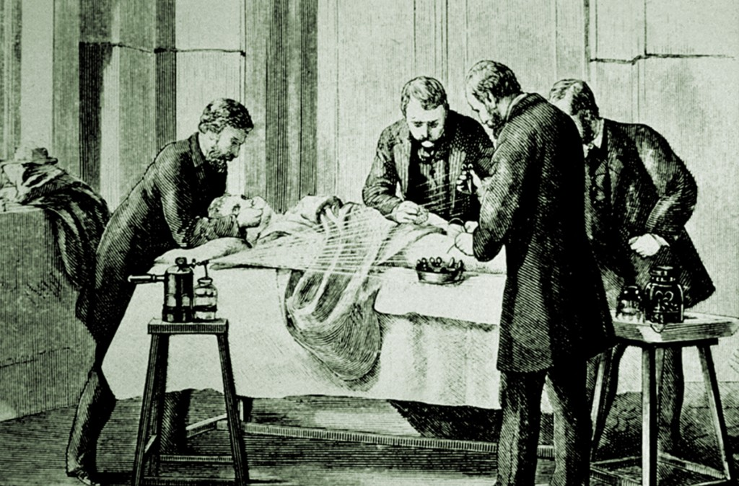
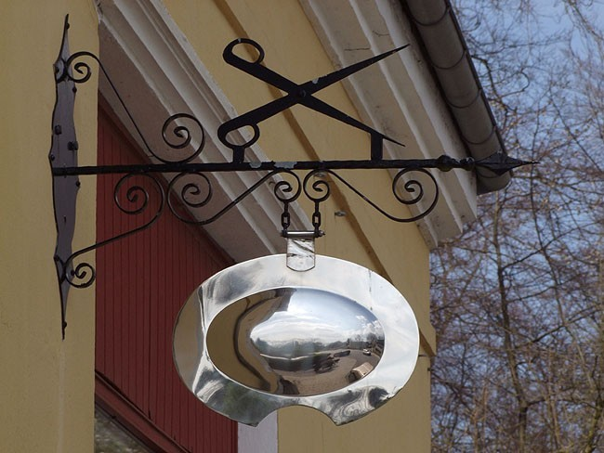
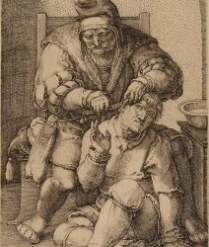
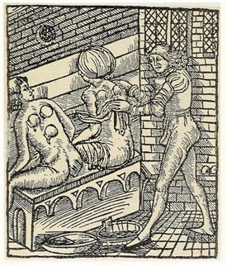
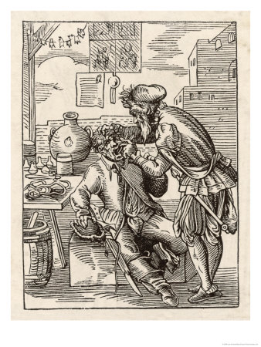
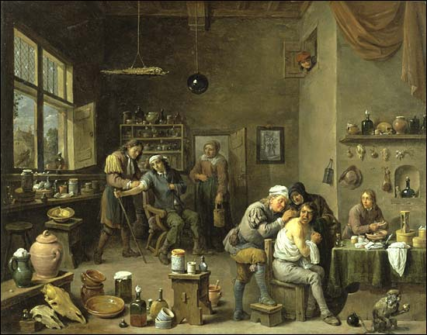
Den tidlige kirurgi
Kirurgi som hånd-arbejde
Mellem bartskærerer og medicus
”Det anstår ikke en hædret læge selv at foretage operationer, men overladende sligt til sine håndlangere, bør han kun foreskrive sine patienter lægedom og diæt.”

Slide 9
Bloodletting
Bloodletting is about lifestyle – as a technology is makes sense to the people using it
Bloodletting is part of a complex system of beliefs and practices
A physical technology that fits into a larger underlying cosmic system
It is practical, easy to manage, effective, visceral, theatrical – often qualities that mark the most widely used technologies

Slide 10
A social view of technology
An expanded view of technology: Not providing necessities but for social development
“Technology is the production of superfluities – today as in the Paleolithic age. That is why animals are atechnical; they are content with the simple act of living.” (José Ortega y Gasset)
Mumford: The first ‘machine’ we know was the slaves used to build dams and irrigation
Necessity is not always the mother of invention – invention is the mother of necessity, tools exists before the problem
When you have a hammer, you look for nails

Slide 11
A social view of technology
Systems definition: “The technological system is the complex of hardware (possibly plants and animals), knowledge, inventors, operators, repair people, consumers, marketers, advertisers, government administrators, and others involved in a technology.”
Machines and civilization are thoroughly entangled – the line between society and technology is indistinct
“The machine cannot be divorced from its larger social pattern; for it is this pattern that gives it meaning and purpose” (Lewis Mumford, 1934)

Slide 12
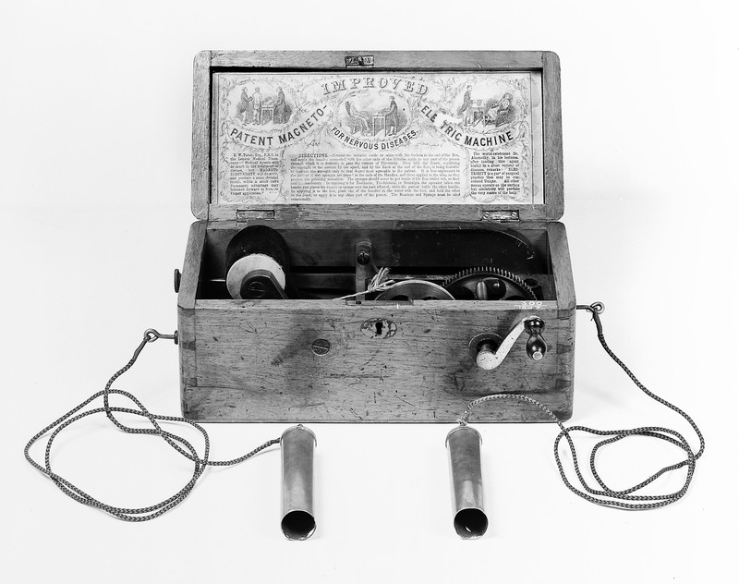

Slide 13
Neurasthenia
From the 18th century onwards, studies of electricity influences medicine
The human body was reconfiogured as an electrical machine, powered by energy distributed through the nervous system – nervous energy as electricity
Building on scientific inquiry into the nervous systems and the brain
Electricity became the main source of urban and industrial energy, the mainspring of modern life

Slide 14
Neurasthenia
From the 18th century onwards, studies of electricity influences medicine
In 1869, George Miller Beard (expert in electrotherapy) coins neurasthenia – ‘weak nerves’
Symptoms included general exhaustion, sensitivity of the spine and body, localized and peripheral numbness, vague pains and neuralgias, temporary paralysis and gastric disorders, headaches, sleep disorders, pressure in the head, deficient mental control, difficulty concentrating, mental irritability, morbid fears (phobias in general), sexual disorders (in males, involuntary emission of semen, partial or total impotence; in females, organ displacement, inflammations, ovarian and uterine irritation)

Slide 15
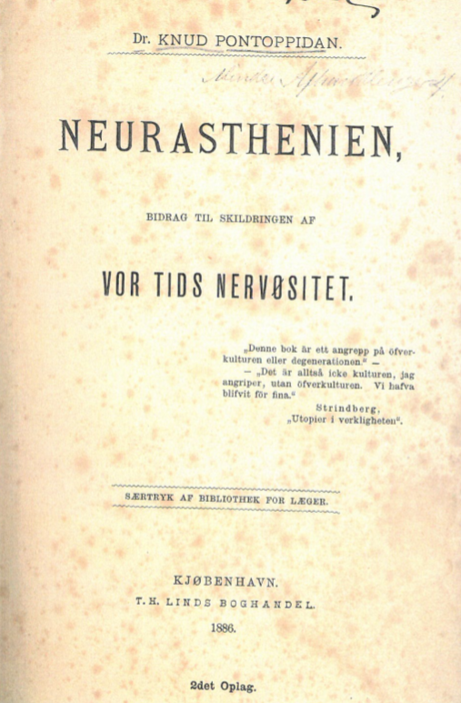
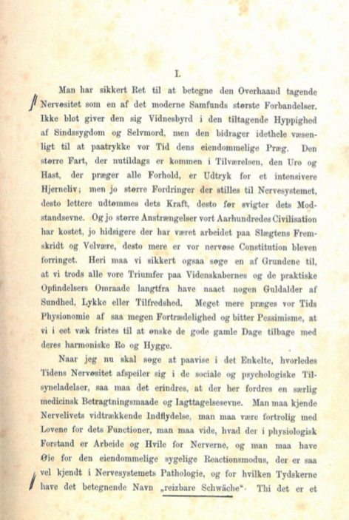

Slide 16
Neurasthenia
Racialized and sexualized – men and women were treated very differently, as were other races
The disease was both deeply cultural and deeply personal, and so provided a metaphorical framework for people to discuss how culture affected their lives and their health – a re-explanation of the world to both the patient and the doctor
Technology and science provides models for the body and health – and vice versa in complicated patterns (fluid bodies, mechanical bodies, information bodies, networked bodies, environmental bodies, etc.)

Slide 17
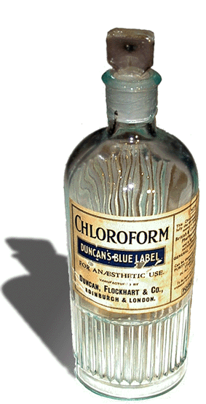
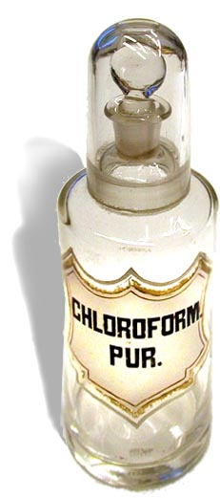

Slide 18
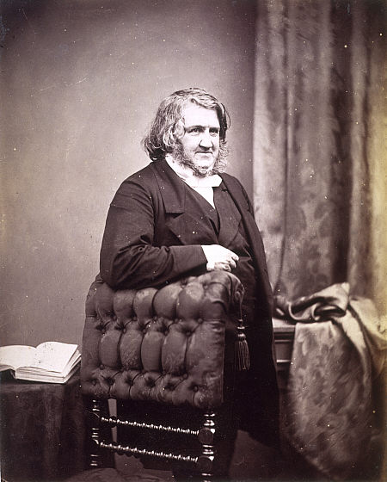
Sir James Young Simpson (1811-1870) – Scottish obstetrician

Slide 19
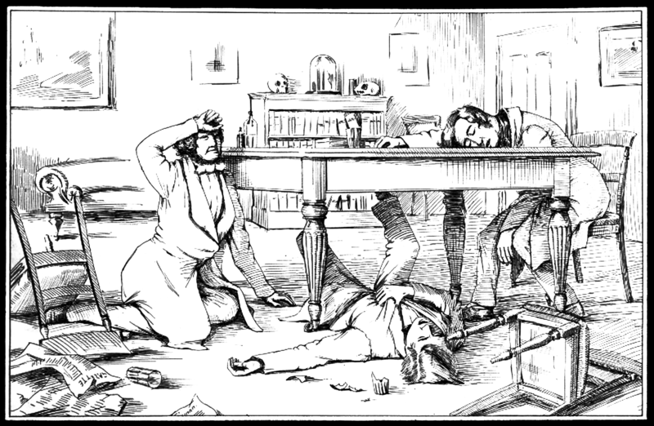
Opdagelsen af kloroform

Slide 20
Opdagelsen af kloroform
Dr Simpson and two of his friends, Drs Keith and Duncan, sat every evening in Dr Simpson's dining room trying new chemicals to see if they had any anesthetic effect. On 4 November 1847 they found that chloroform was a potent anesthetic.

Slide 21
Chloroform could do what ether could not: Deep anesthesia without excitation
Four days later he used chloroform during a labor
Six days later he gave a lecture for his medical and surgical peers
Eleven days after the discovery he gave the first public presentation
On the same day he published a booklet which was sold in more than 1500 copies
One month later he was using chloroform as part of his everyday work

Slide 22
Three major objections: Safety, religion and propriety
On safety:
Noone knew exactly how it should be dosed and how it affected the child
By 1863 there had been 123 documented and many more suspected deaths due to chloroform
But this was a minor debate and very little controlled experimentation was undertaken – debates were often held over individual cases

Slide 23
Religious concerns:
Women were punished in the bible with the pain of childbirth – removing that pain would be breaking a sacred bond with God
Chloroform was “a decoy of Satan, apparently offering itself to bless women; but in the end…it will harden society, and rob God of the deep earnest cries which arise in time of trouble for help.”
Simpson: “the very fact that we have the power by human means to relieve the maternal sufferings, is in itself a sufficient criterion that God would rather that these sufferings be relieved and removed.”
Also God had used anesthesia on Adam: “The Lord caused a deep sleep to fall upon Adam; and he slept; and he took one of his ribs…”

Slide 24
Propriety and indecency
Medical men were taking over childbirth but this created delicate social problems and required a rhetorical and practical efforts to control
“it is as if the Almighty, in creating the female sex, had taken the uterus and built the woman around it”

Slide 25
“In one of the cases observed by Baron Dubois, the woman drew the attendant towards her to kiss, as she was lapsing into insensibility, and this woman afterwards confessed to dreaming of coitus with her husband while etherized … erotic gesticulation have been observed … the woman went unconsciously through the movements attendant on the sexual orgasm… [removing pain is good] … to the woman of this country the bare possibility of having feelings of such a kind excited and manifested in outward uncontrollable actions, would be more shocking even to anticipate, than the endurance of the last extremity of physical pain.”
(W. Tyler Smith, “On the Utility and Safety of the Inhalation of Ether in Obstetrical Practice”, 1847)

Slide 26
“There appears, therefore, apart from considerations of safety, to be a moral objection to the administration of the anesthetic agents now in use – one which should unite against them all men who desire to uphold the respectability of the obstetric department of medicine; for most assuredly, the present kind of attendance could not continue of the facts were understood by parents and husbands.” (Lancet, 1848)

Slide 27
Chloroform and the meaning of pain
Simpson argued against those who said the pain was natural, arguing it was neither beneficial nor uncomplicated
Pain is something to be saved from, producing only anxiety, dread, exhaustion and nervous depression
As scientific medicine progressed pain and illness lost their religious and existential meaning, instead giving way to a more biological understanding of life and pain
Knowledge and control over nature and biology grew and attitudes towards health, illness and childbirth changed

Slide 28
