Slide 1
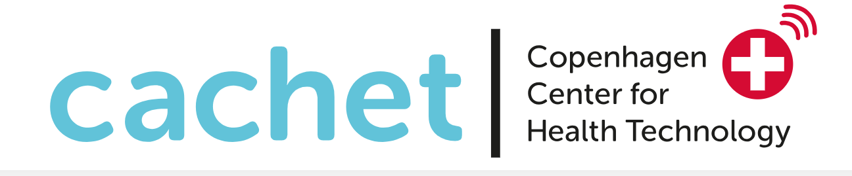
FitMum study update, and the potential of data-driven discoveries
Saud Alomairah, MPH, PhD student

Slide 2
Content
What is FitMum?
Baseline data and some insights
Future results and potential discoveries

Slide 3
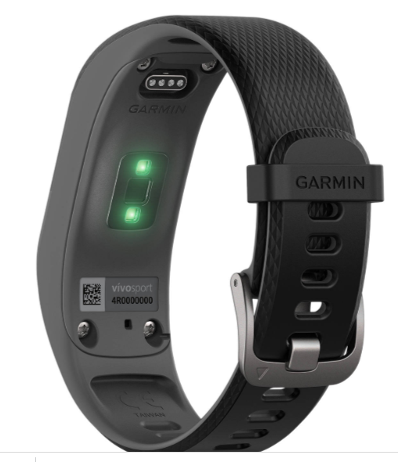
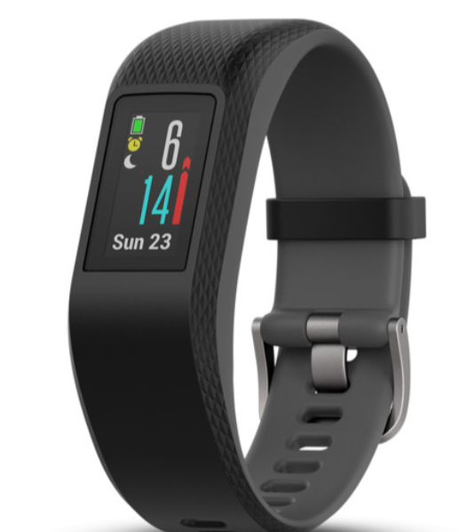
What is FitMum?
It is a Randomized Controlled Trial (RCT).
We investigate how to implement Physical Activity (PA) in pregnant women´s everyday life.
We examine the effects of two different exercise programs, structured exercise and motivation counseling supported by health technology, on physical activity level during pregnancy.
We started October 2018 and will end in 2022.

Slide 4




What is FitMum?
220
Structured exercise
87
Group & individual motivational counseling
87
Control
45
Notes:
COVID period

Slide 5
What is FitMum?
Randomization
Primary end point
Follow-up FitBaby
Tracker
App. 12 weeks of intervention
Pregnancy
Visit 1
(gestational age <15)
Visit 2
Primary outcome
Visit 3
Visit 4
Delivery (end of intervention)
Visit 5
Visit 6
(End of study)
Start Oct 2018
Primary outcome completion
March 2021
Last birth May 2021
Last postpartum
May 2022

Slide 6

Baseline data (demographics)
Mean Age= 31,5 years (21-46 )
GA=11.3 weeks
(6 -15)
BMI=25,7

Slide 7


Baseline data (demographics)
Number of kids
Pre-conception
BMI=25.7
%
0 | 1 | 2 | 3
37.27 | 45.45 | 5.00 | 2.27

Slide 8


FitMum Babies
FitMum’s Babies
21
Last due date
25-05-2021
155

Slide 9
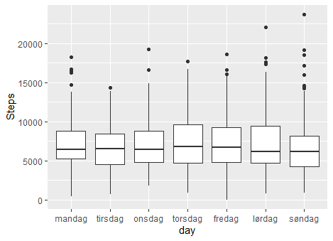
Some insights

Slide 10
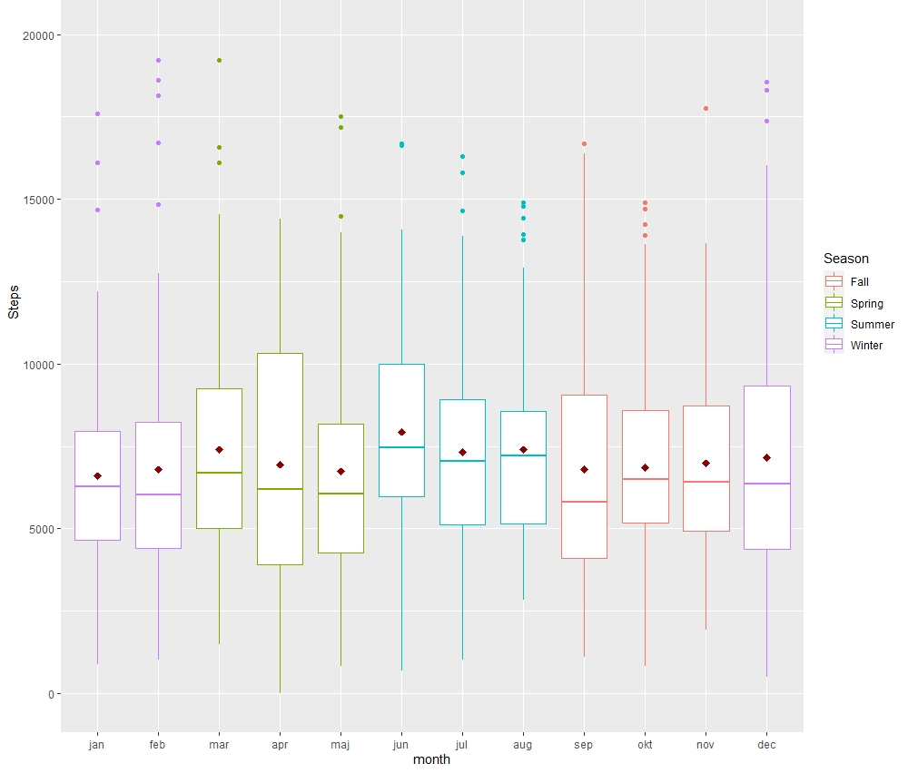
Baseline data

Slide 11
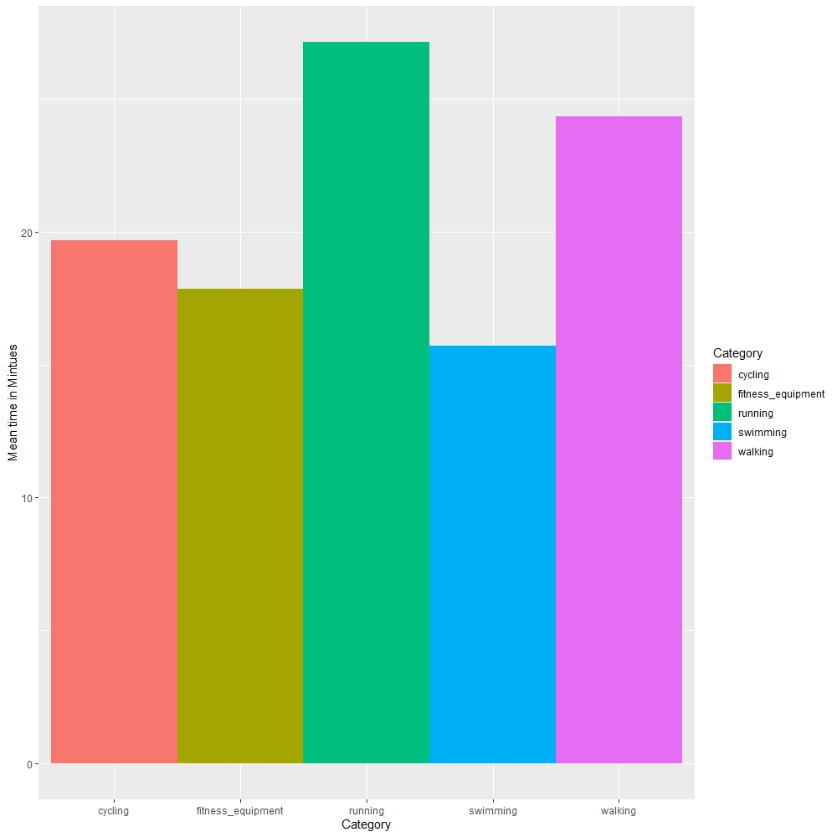
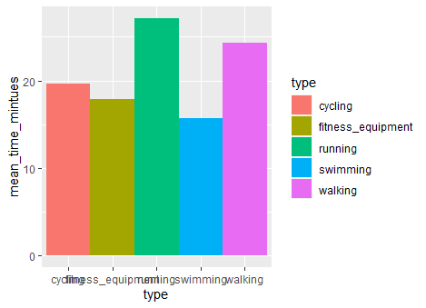

Slide 12
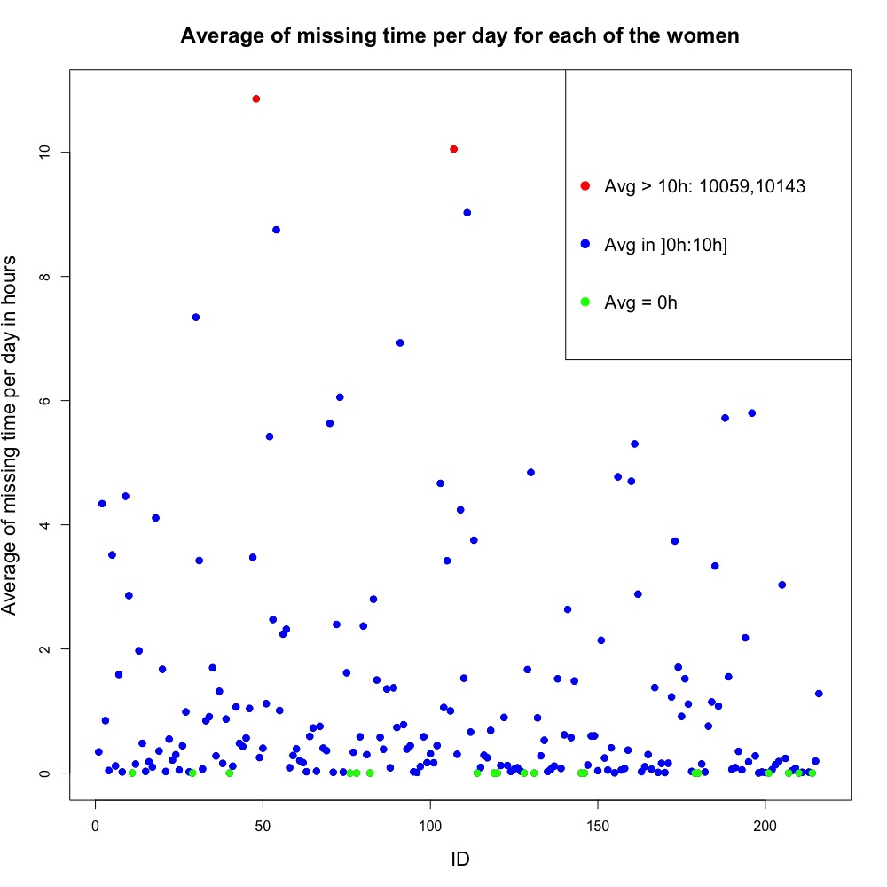

Slide 13
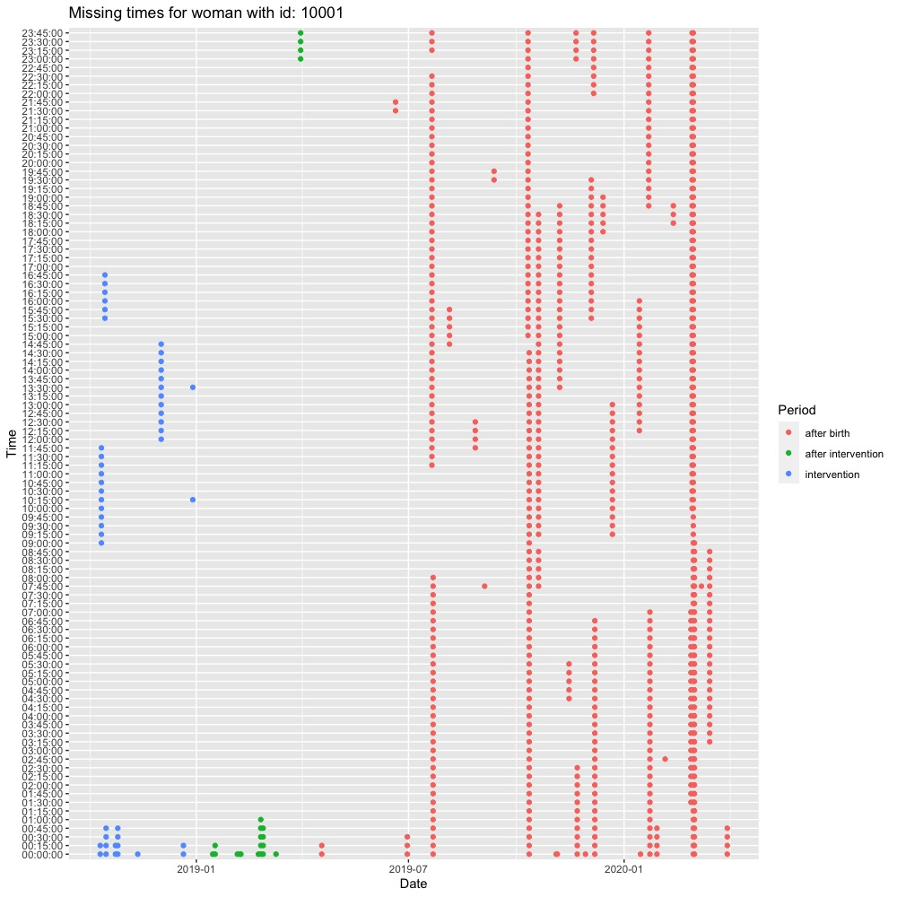

Slide 14



Over 300 million heart rate observations in total
In average 320 days of measurement for each participant
Around 90,000 sleep nights in total

Slide 15
Future results and potential discoveries
Two physical activity interventions examined in RCT, and with consumer-based activity tracker as measurement & intervention tool.
Data from the activity tracker is comprehensive, and the compliance of wearing it is high.
Besides physical activity, we investigate clinical and health outcomes in the mothers and their babies.
We follow participants one year after birth and their babies as well.
Protocol paper just accepted for publication in BMJ Open, and more to come soon ☺

Slide 16

Acknowledgement of research team and funding
Research team
University of Copenhagen: Caroline Roland, Saud Alomairah, Anne Dsane Andersen, Bente Stallknecht, Romain Barrés, Ole Mortensen, Gerrit van Hall, Astrid Jespersen, Andreas Jensen
Nordsjælland’s Hospital: Signe Knudsen, Ellen Løkkegaard, Tine Clausen, Jane Bendix, Stig Mølsted
Technical University of Denmark: Jakob Eg Larsen
Aarhus University: Helle Maindal
Deakin University: Bodil Rasmussen, Ralph Maddison
University of Graz: Mireille van Poppel
Funding
Independent Research Fund Denmark
Tryg Fonden
Copenhagen Center for Health Technology
Saudi Electronic University
University of Copenhagen
Nordsjælland’s Hospital
Aase og Ejnar Danielsens Fond
Beckett-Fonden
Familien Hede Nielsens Fond

