Slide 1
Behavioral design
Robin van Oorschot & Dagný Valgeirsdóttir

Slide 2
Every design changes behavior
(not always intentionally..)

Slide 3

We designed the car, but we did not design the traffic jam

Slide 4
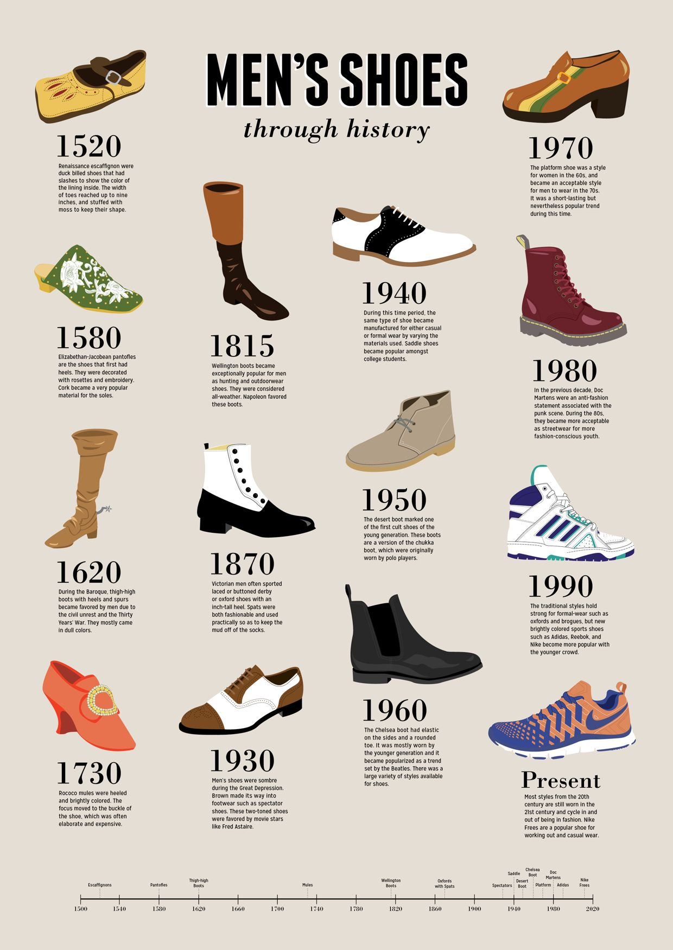
Changes in behavior can be very subtle

Slide 5
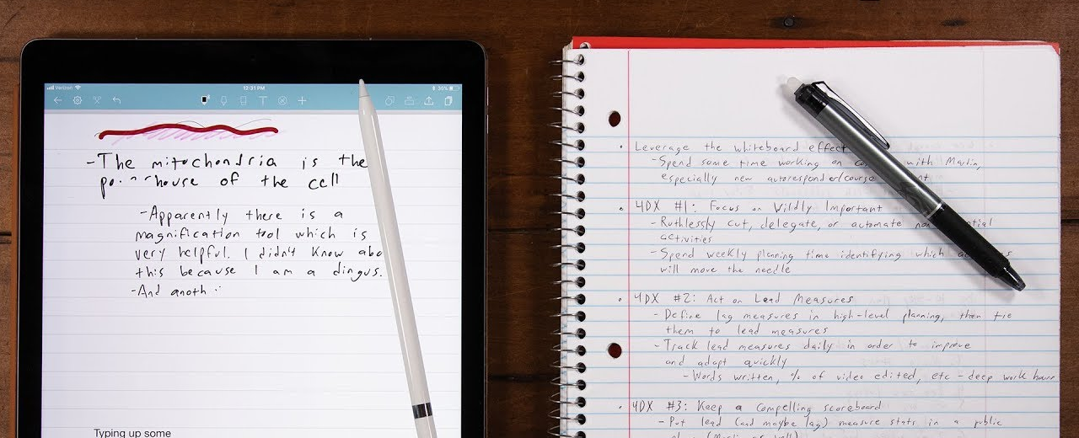
Sometimes, the functionality is the same, but the way we use it becomes different

Slide 6
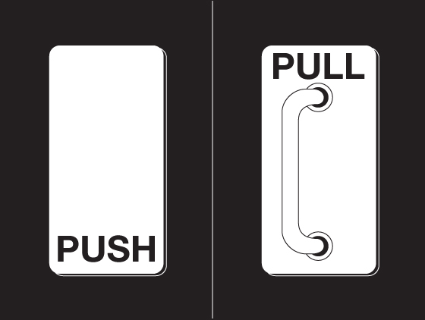
But we can consciously design to change behavior
Notes:
DV: Like this

Slide 7
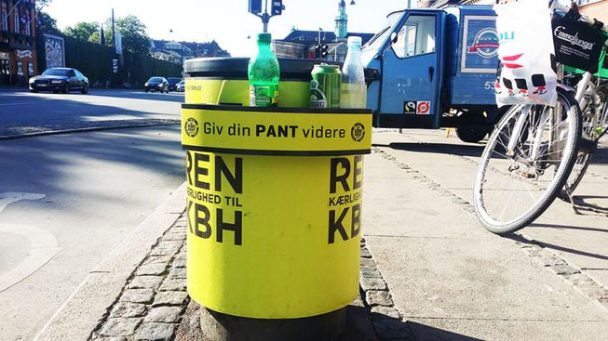
Change behavior with a purpose in mind
Notes:
DV: And this

Slide 9
Current project
Cachet project on Design for behavioral change in Healthcare
  Focused on startups
Collaboration with Hedia and Daman
  Software assistance for Diabetes, Rheumatism, Chronical illness, Cancer
Outcome will be a support tool for SME’s aspiring to do behavioral design in Healthcare
Notes:
DV: Added a third point and changed the headline

Slide 10
Challenges for Behavioral design in Healthcare
Health and security always comes first
  In contrast, a lot of ‘fun’ project focus on explorations and ‘making it fun’
You cannot just test behavioral design prototypes all the time
  The research phase needs to be in-depth
Healthcare projects are not about behavioral design in the first place!

Slide 11
Desired Behavior
Design Intervention
Successful behavior

Slide 12
Desired Behavior
Design Intervention
Successful behavior

Slide 13
Desired Behavior

Slide 14

How to avoid it? How to deal with it? How…?

Slide 15
Desired Behavior
General Interest

Slide 16
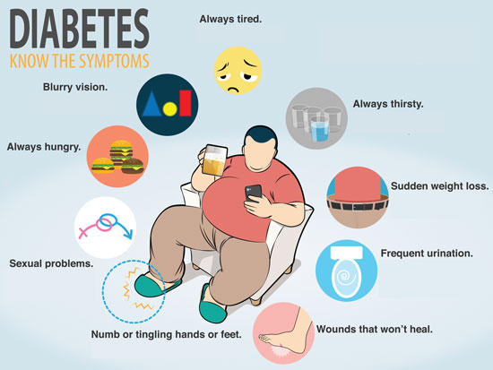

Slide 17


Slide 18
Desired Behavior
General Interest
Personal Interest

Slide 19


Slide 20


Slide 21
Desired Behavior
General Interest
Personal Interest
Being in the position to act

Slide 22


Slide 23
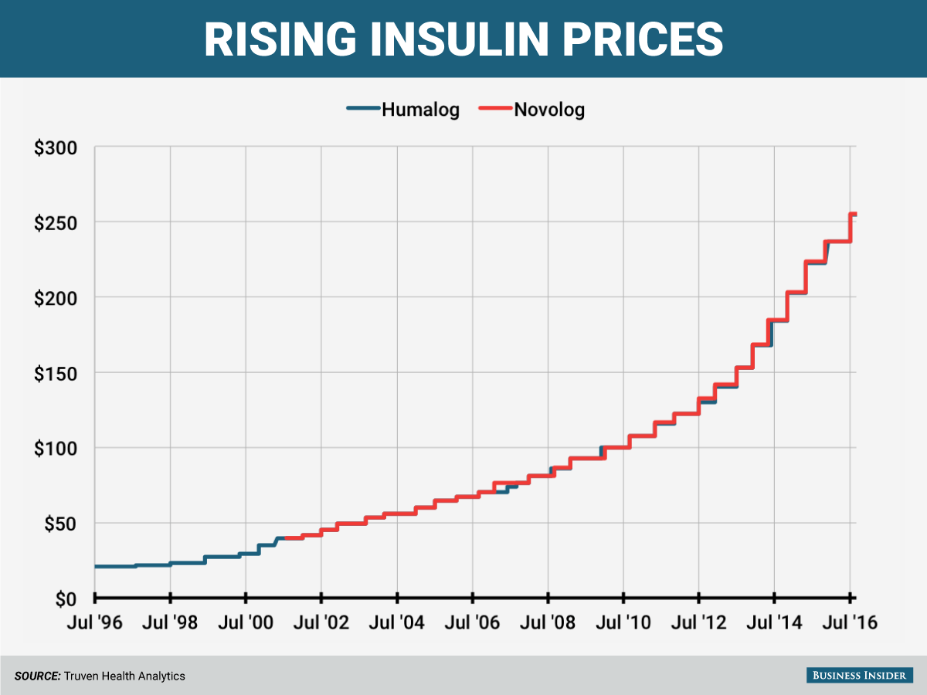

Slide 24
Desired Behavior
General Interest
Personal Interest
Being in the position to act
Make it a specific goal

Slide 25
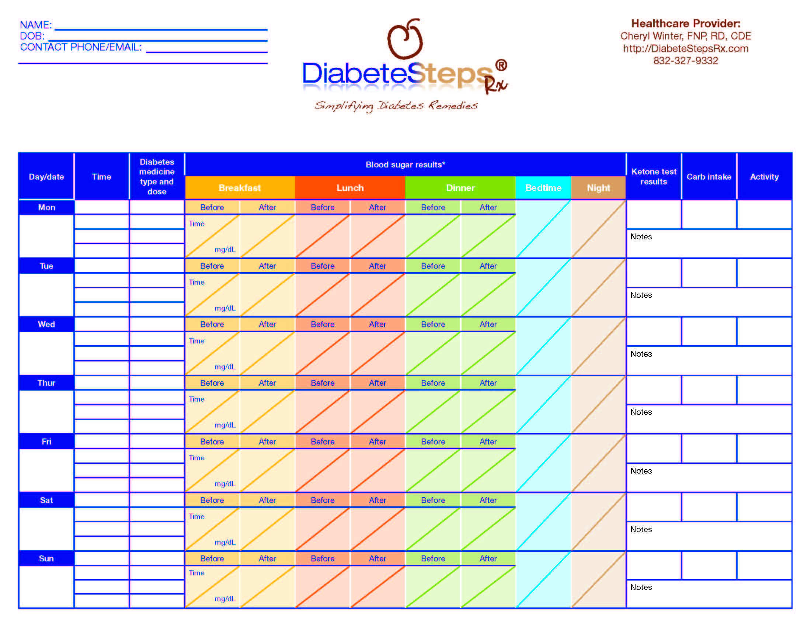

Slide 26


Slide 27
Desired Behavior
General Interest
Personal Interest
Being in the position to act
Make it a specific goal
Choose this goal

Slide 28



Slide 29
Desired Behavior
General Interest
Personal Interest
Being in the position to act
Make it a specific goal
Choose this goal

Slide 30
For every step, what can you do, and what do others already do. And to which extend to you depend on these others?
Perhaps, your focus should not be on changing the desired behavior, but on one of the other steps of the process
Desired Behavior
General Interest
Personal Interest
Being in the position to act
Make it a specific goal
Choose this goal

Slide 31
Desired Behavior
General Interest
Personal Interest
Being in the position do act
Make it a specific goal
Choose this goal
Desired Behavior
Design Intervention
Successful behavior

Slide 32
Design Interventions
How to translate all these behavioral design insights into a design?
  Several processes
  Several tools
  I touched on some of them already..
Beyond the scope of today’s presentation..
  We do however work with this a lot, so please contact us at roor@dtu.dk or dagnva@dtu.dk if you are interested and want to know more

