Slide 1
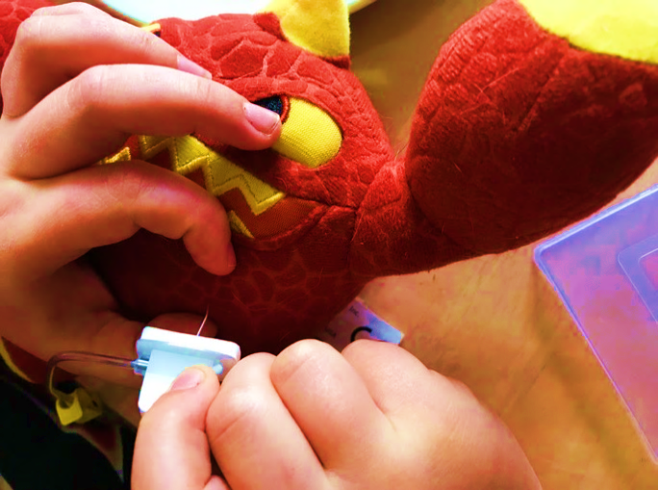
“Minor creations of self-care for life with chronic disease and technology
– installed base for eHealth?”
Cachet seminar– 27-05-19
Claudia Bagge-Petersen, PhD-student
Section for Health Services Research, Department of Public Health,
Copenhagen University
Notes:
Me
This presentation will be about children and young people with chronic diseases, their norms for a good everyday life, their challenges in daily management, their own ways of dealing with these challenges, and not least how technologies are part of this. And how knowledge about everyday life, self-care and –management is important for eHealth design.

Slide 2
Why this project?
The problem about eHealth for minors

Slide 3
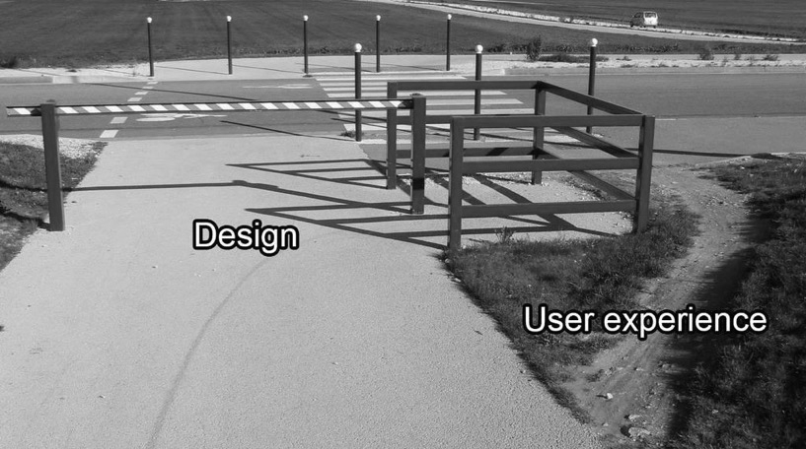
Discrepancy between eHealth imposed self-care and minors daily life with disease
eHealth self-care
Minor tactics
Notes:
Okay so! In recent years we have seen a rapid growth in the testing and trialing of eHealth solutions for children and young people.
eHealth is continuously being promoted as the enabler of self-care and self-management for people with chronic diseases and increasingly also for children and young people.
But although reviews speak to the potential of eHealth, they demonstrate both weak and mixed evidence about the self-care, that the solutions try to induce. Solutions are not used, or have limited effects. So, what cause this discrepancy between eHealth-imposed self-care and minors daily life with disease? What kind of self-care practices are already present, that the eHealth is to be weaved into?

Slide 4
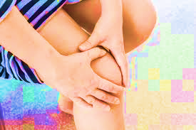
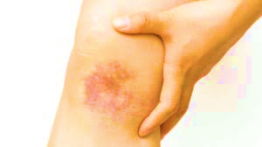
Fieldwork amongst minors with hemophilia and Juvenile Rheumatoid Arthritis
Notes:
To provide suggestions for an answer, I did ethnographic fieldwork amongst 17 minors between the age of 7 and 17 suffering from hemophilia and Juvenile Rheumatoid Arthritis. I chose these disease areas, because eHealth solutions are under development for both patient groups. The eHealth solutions, that I am also following ethnographically, are apps that want to promote self-care and –management through registration and correlation of symptoms and treatment.
So, I investigate ethnographically everyday life for minors with hemophilia and arthritis to account for self-care as it is formed in daily living before the use eHealth.

Slide 5
Findings of self-care

Slide 6
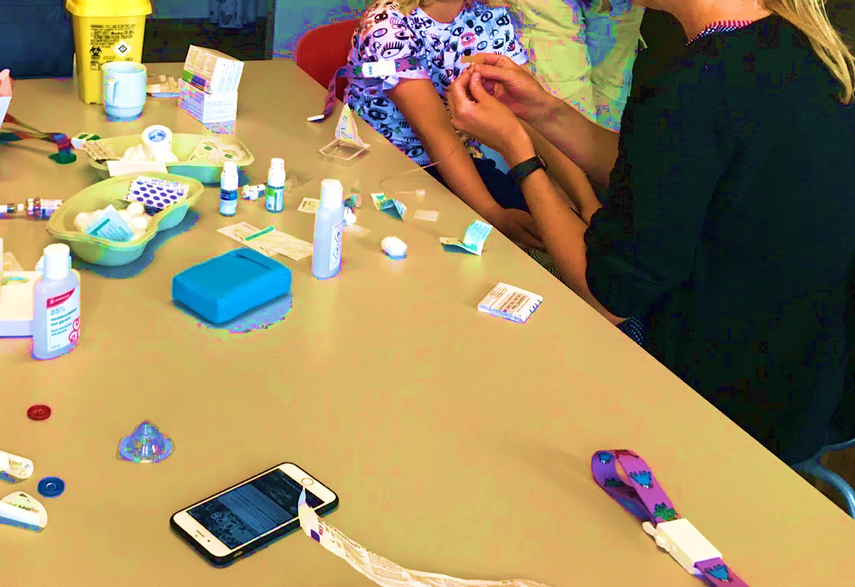
Establishing frames and routines for home treatment
- sticking to establish a script through trial and error
Notes:
Both the minors with hemophilia and the minors with arthritis have to get regular injections at home. This is a stressful procedure. The families struggle with establishing frames and routines for home treatment. When families have finally found a routine that works, they stick to that script until the minor feels comfortable enough to change it.

Slide 7
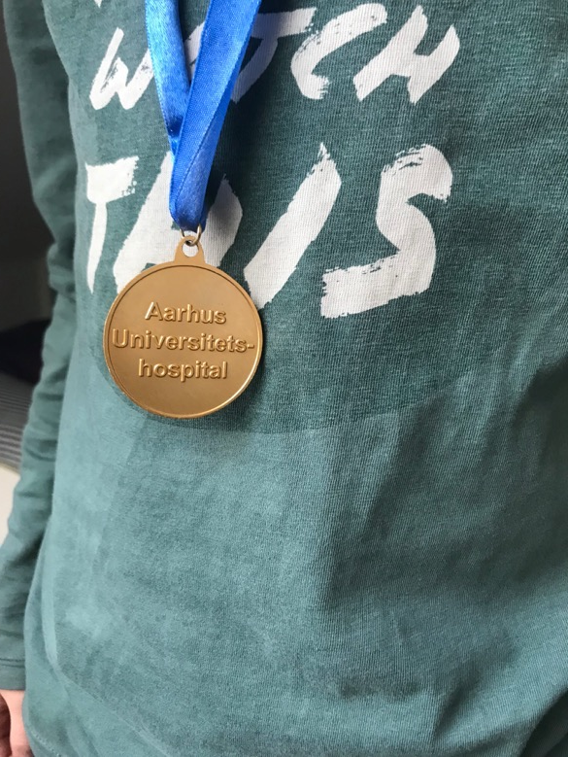
Mathias and the story of home treatment
Notes:
I visited Mathias who has hemophilia, and he and his family told me about when he was younger, and very frightened of the home treatment procedure. Before injections Mathias would run off over the fields outside the house in his underwear, to escape.
Mathias is 11 years old when I visit him. It is a long time since he ran trying to escape the injection. When they found out they could use an anesthetic cream, Mathias agreed to give home treatment a second chance. While I was there, I observed Mathias getting treatment, which happened like this:

Slide 8
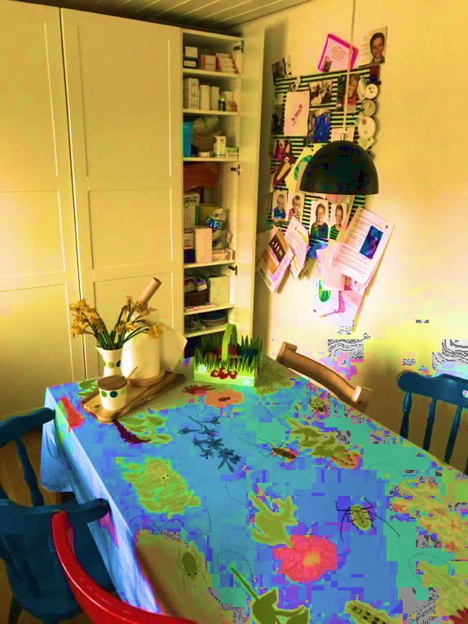
1-2-3-now
Notes:
Mathias is lying on a quilt on the dining table. He has no shirt on and lies on the table looking at his smartphone. He is very focused, not moving his eyes away from the phone while the father is preparing the medicine. The father puts on rubber gloves. He wipes away the anesthetic cream from Mathias’ chest and take the needle that is attached to a tube with a plastic mechanism in the end. He tells Mathias to put down his left arm and relax it. Mathias stretches his legs and left arm. The father asks if Mathias is ready. Mathias then counts “1-2-3-now” and the father puts his fingers on Mathias’ chest fixating the port-a-kath,

Slide 9
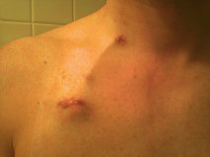
Port-a-cath – implanted device for injections
Notes:
Which is an implanted device under the skin that makes it possible to inject the medicine. The father pushes the needle through the skin.

Slide 10
Home treatment has a tight self-found script
Notes:
While he does that, Mathias’ abs tighten. The father attaches the syringe to the mechanism on the tube and opens the plastic lock on it making sure that blood is flowing into the tube. He then injects different fluids and takes out the needle. Mathias, that was quiet until now, urges his father to hurry up; there is only 4 minutes till football practice. One of his friends is already over there, he says, which he knows from Snapchat on his phone. The father places a band-aid on the skin and Mathias rush out the door.
As we see this whole home treatment is scripted. It is a ritual. Every actor knows its place and collaborate to make the treatment happen. Mathias’ tightening of the abs is a signifier, of the hard mental and physical control he performs. His holding on to the smartphone and social media might be his way of holding on to normal life.

Slide 11
Separation between disease and normal life
Notes:
In my study I found, that the minors with chronic diseases, almost never share anything about their disease on social media. On social media it is about being your best self and normal. Disease and normal minor life is attempted to be kept strictly separate, due to norms about self-presenting. Pointing out the differences between himself and his peers, would not be productive for engaging in communities of equals. And equal to peers is what he wants to be, not treated any different than the others.
However the smartphone can be involved in home treatment, as a tactic for mental connection to normal life, while the body is object to treatment. In the situation of smartphone distraction during home treatment, the minor’s relation with social media technologies, makes it possible to be somewhere else and care for the communities of friends, while the treatment technologies are , at the same time, relating to his body, to make the blood capable of coagulating, thus ensuring that the minor body is not leaking in the physical encounters with peers’ bodies in football practice a little later.

Slide 12
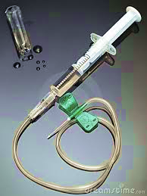

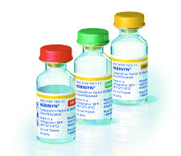
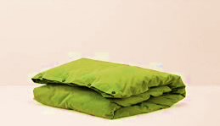
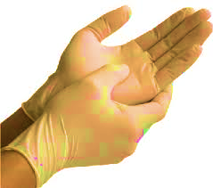
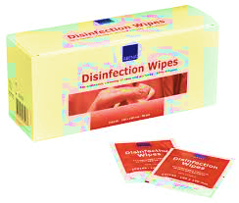
Interembodiment arrangements of treatment
Notes:
I found that management of the disease cannot be reduced to the practice of one person but both parents, minor and a lot of different objects – I term this “interembodiment arrangements”. All of these actors has to fulfill a role to tame both the minor body and the disease itself. And more than that; actors like the quilt, smartphone and social media are tactical objects to stay connected to the world of normal life, while the injection is happening. So, we see that objects play a crucial role for facilitating disease-management that both treat the minor and makes sure that he can return to a status of a normal child.
Earlier that day, when I visited Mathias, he showed me a medication kit, identical to the one they use at home treatment, that he can play with.

Slide 13
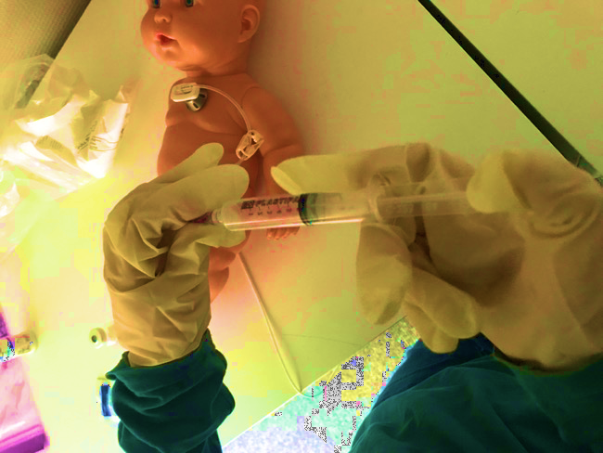
Mathias performs treatment on his sister’s doll
Notes:
With this “toy” kit, he has a doll that he borrowed from his sister. There is a port, just like Mathias’, attached to the doll’s chest on top of its plastic skin. Mathias shows me how he plays. He puts on adult-sized rubber gloves. He shows how to disinfect, and then he inserts a needle into the port. He explains how to press the medicine inside with the syringe. And tells me that he has to clean afterwards with saltwater and heparin. He makes sure to open and close the tube with the yellow plastic mechanism before and after injecting something new. When he is done, we go back down to the kitchen, and Mathias tells me that they once attended a family weekend for children with hemophilia, and that he there tried inserting a needle in a plastic arm with plastic veins in it.

Slide 14
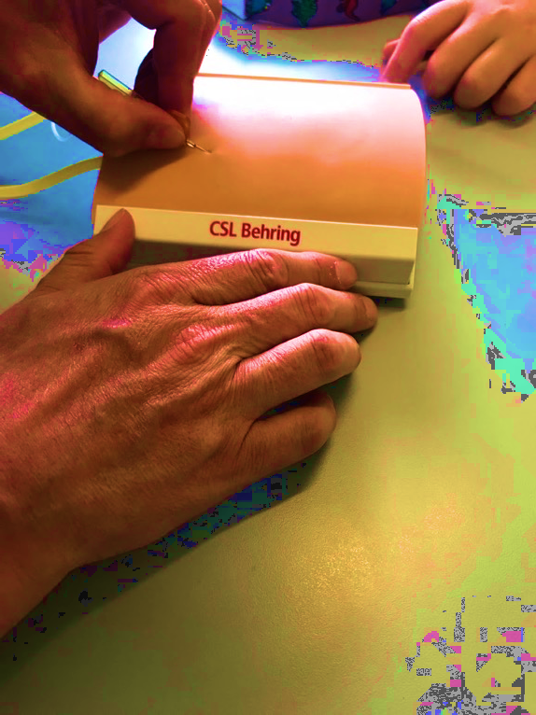
Practice on plastic arm
Notes:
But it went wrong, he tells me in a serious tone, because another child accidently bumped into him and he stung himself in the other hand with the needle.

Slide 15
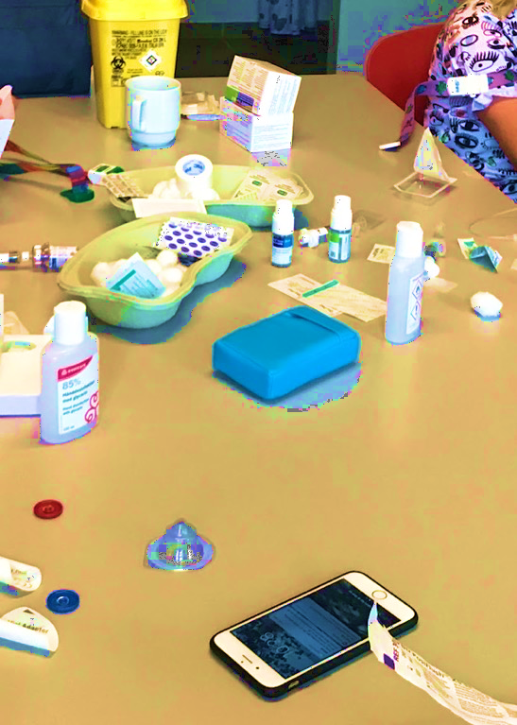
Imitation games of the link between medical devices, treater and the treated
Notes:
I term these minor experimentations with the medical devices; “imitation games”. Mathias is trying to get an overview of the otherwise integrated or hidden infrastructure and practices of the home treatment. In the real treatment situation, he cannot explore the relations between devices and bodies, because of his objectified role, and physical outlook from the table. In the game, he organizes and designs a network of actors to play out these imitations. He investigates, relates and shifts roles between actors.
When Mathias stings himself with the needle during an imitation, it is a clash between him playing, and the real thing; a matter out of the imitation script, where he was supposed to be the treater, and not the one whose skin was stung. In that situation, he might learn that there has to be peace and quiet around the injection moment. Failures in the imitation games are better than in real treatment.
The minor thus explores and imitates the link between the treater and the treated. In the future the minor will have to play both roles at once – so these imitation games might be seen as an exercise in exactly that.
I therefore propose, that we recognize minor self-care as; a routinized, but fluent set of practices, where the role of “the treater” is gradually taken on by the minor, in a complex interembodied experience between his body, parents, medical devices and other everyday life technologies.
The question that remains is what these observations and analytical points imply for eHealth design.

Slide 16
Implications for eHealth design for minors

Slide 17
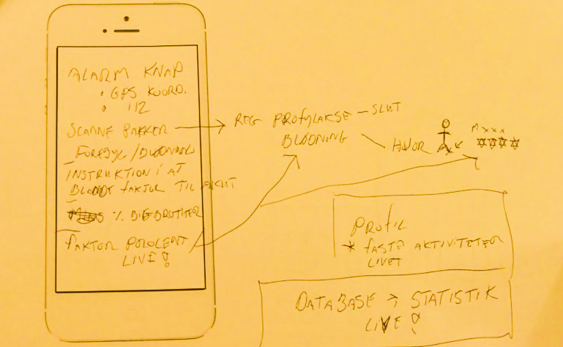
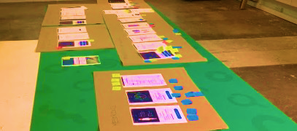
Installed base for eHealth design
Notes:
We might tend to think that digital and technological self-management start when patients get an eHealth app or self-monitoring device. But I argue that these chronically ill minors have already established self-care and self-management practices, that the eHealth solutions are then to be integrated with.
I thereby argue that eHealth developers should be concerned with an ”installed base” not only as covering existing devices, infrastructures, connection and it-competences, but also patients’ own rationales for involving and not involving technology in their disease life and life in general.
It will make a difference for the use of a particular eHealth design, that;
the smartphone is practiced as non-disease spaces,
that self-care is a multi-actor-process,
and that disease and management-learning is creative and self-initiated.

Slide 18
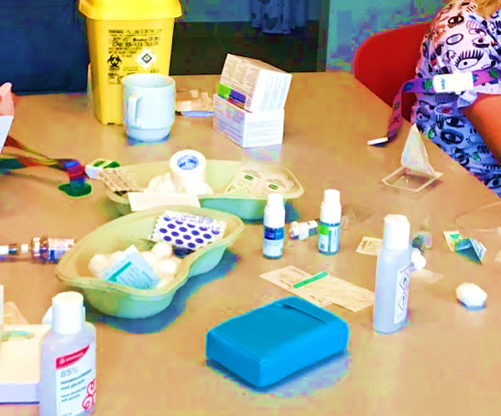

There is an installed base of both technology and practices of self-care and management
Self-care is about:
Ritualization and separation of disease space → Design for specific disease spaces, not everyday life (might contradict holistic ambitions in telemedical innovations)
Interembodied arrangements performing management → design for situations and arrangements rather than “a user”
Imitation games → design for practices in proces rather than goals and results. The games are serious!
Notes:
We cannot assume that minors and families cast away there own scripts for self-care and management to adopt an eHealth imposed script of tracking symptoms and treatment to better achieve compliance. The important thing for the families is that disease do not take up space, that disease is not intervening with relations to peers, and that minors take on the role of management in small iterative steps.
The point about:
Ritualization and separation of disease space means that we must design for specific disease spaces, not everyday life (might contradict holistic ambitions in eHealth innovations)
Interembodied arrangements performing management means that we must design for situations and arrangements rather than one user
Imitation games means that we should design for procesual practice rather than goals and results. The games are serious!
These points account for the cases where eHealth tries to induce better self-care and self-management. There are other cases where eHealth focus on delivering health-care rather than self-care, and here the case might be different.

Slide 19

Discussion points
Whose challenge is eHealth to solve?
How can eHealth innovation learn about this kind of installed base throughout the design process?
How can eHealth support the interrelated processes of disease management that are already formed?
Notes:
(læs op)

Slide 20
References
An, J.-Y., Hayman, L. L., Park, Y.-S., Dusaj, T. K., & Ayres, C. G. (2009). Web‐based weight management programs for children and adolescents: a systematic review of randomized controlled trial studies. Advances in Nursing Science, 32(3), 222-240
Aanestad, Margunn, Miria Grisot, Ole Hanseth, and Polyxeni Vassilakopoulou. 2017. Information Infrastructures within European Health Care. doi:10.1007/978-3-319-51020-0.
Akrich, M edited by W. E. Bijker, J. Law(1992). The De-Scription of Technical Objects In Shaping Technology/Building Society: Studies in Sociotechnical Change, pp. 205-224 by
Deacon, A. J., & Edirippulige, S. (2015). Using mobile technology to motivate adolescents with type 1 diabetes mellitus: A systematic review ofrecent literature. Journal of Telemedicine and Telecare, 21(8), 431-438. doi: 10.1177/1357633x15605223
Fergie, Gillian. 2015. “Understanding Young Adults ’ Online Engagement and Health Experiences in the Age of Social Media : Exploring Diabetes and Common Mental Health Disorders Gillian M Fergie , MA , MSc Submitted in Fulfilment of the Requirements for the Degree of Doctor of Ph.” http://theses.gla.ac.uk/6362/.
Fisher, E., Law, E., Palermo, T. M., & Eccleston, C. (2015). Psychological therapies (remotely delivered) for the management of chronic and recurrent pain in children and adolescents. The Cochrane Library.
Guljas, R., Ahmed, A., Chang, K., & Whitlock, A. (2014). Impact of telemedicine in managing type 1 diabetes among school-age children and adolescents: an integrative review. Journal of pediatric nursing, 29(3), 198-204.
Lupton, Deborah. "Infant embodiment and interembodiment: A review of sociocultural perspectives." Childhood 20.1 (2013): 37-50.
Marcano Belisario, J. S., Huckvale, K., Greenfield, G., Car, J., & Gunn, L. H. (2013). Smartphone and tablet self management apps for asthma. Cochrane Database Syst Rev, 11(11).
Nickels, A., & Dimov, V. (2012). Innovations in technology: social media and mobile technology in the care of adolescents with asthma. Current allergy and asthma reports, 12(6), 607-612.
Wesley, K. M., & Fizur, P. J. (2015). A review of mobile applications to help adolescent and young adult cancer patients. Adolescent health, medicine and therapeutics, 6, 141.
Ye, X., Bapuji, S. B., Winters, S. E., Struthers, A., Raynard, M., Metge, C., Kreindler, S. A., Charette, C. J., Lemaire, J. A., & Synyshyn, M. (2014). Effectiveness of internet-based interventions for children, youth, and young adults with anxiety and/or depression: a systematic review and meta-analysis. BMC Health Services Research, 14(1), 1.

Slide 21






Acknowledgement
Funding from:
Principal supervisor: Head of Section, Associate professor Henriette Langstrup
&
Co-supervisor: Associate professor Morten Skovdal
Primary co-supervisor:
Head of Research at BBH
Anne Frølich
Co-supervisor: Associate professor Jakob Eg Larsen
&
Notes:
Thank you!

