Slide 1




Data Driven User Experience for Personalizing Hearing
CACHET Spring Seminar 2019

Slide 2
Table of Content
Motivation
Current Fitting Paradigm

Slide 3

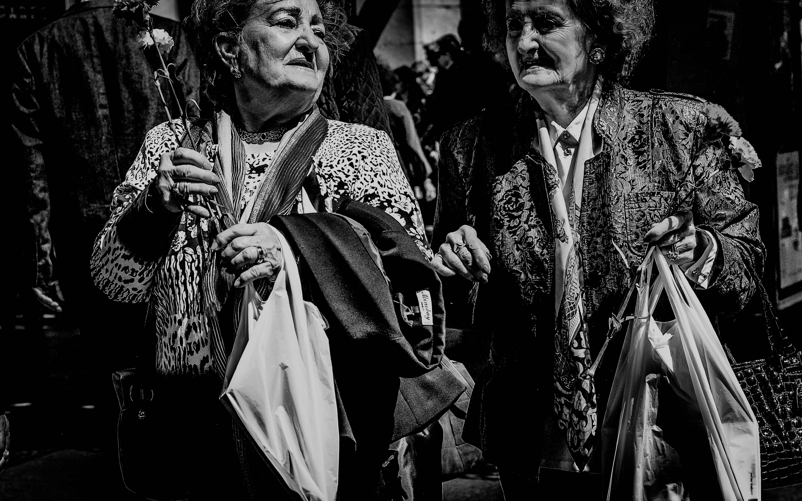
hearing
impairment
affects
someone you know
Rubén Bagüés, CC

Slide 4
hearing
impairment
affects
1 out of 5
WHO 2015
Rubén Bagüés, CC

Slide 5
annual cost
£30 billion
Archbold et al. 2014
Rubén Bagüés, CC

Slide 6
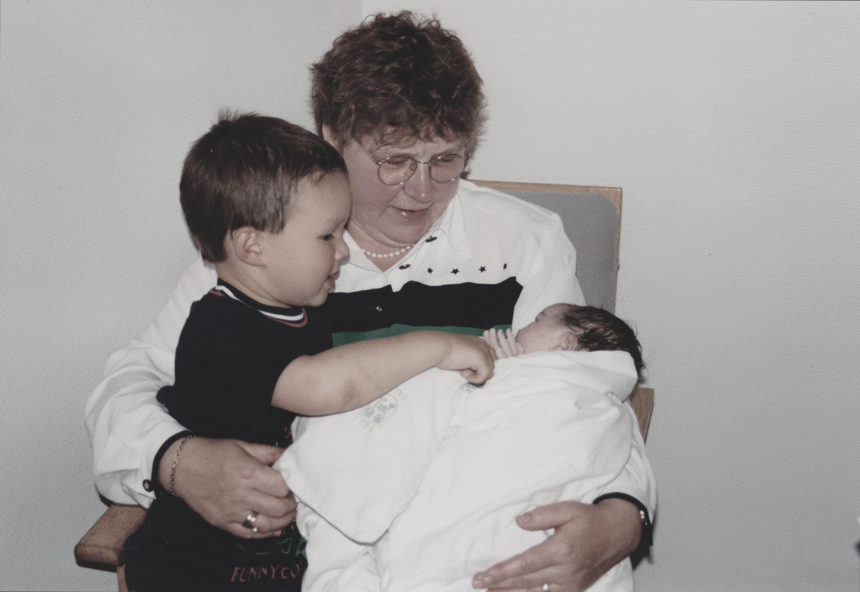

Slide 7
The Current Fitting Paradigm

Slide 8
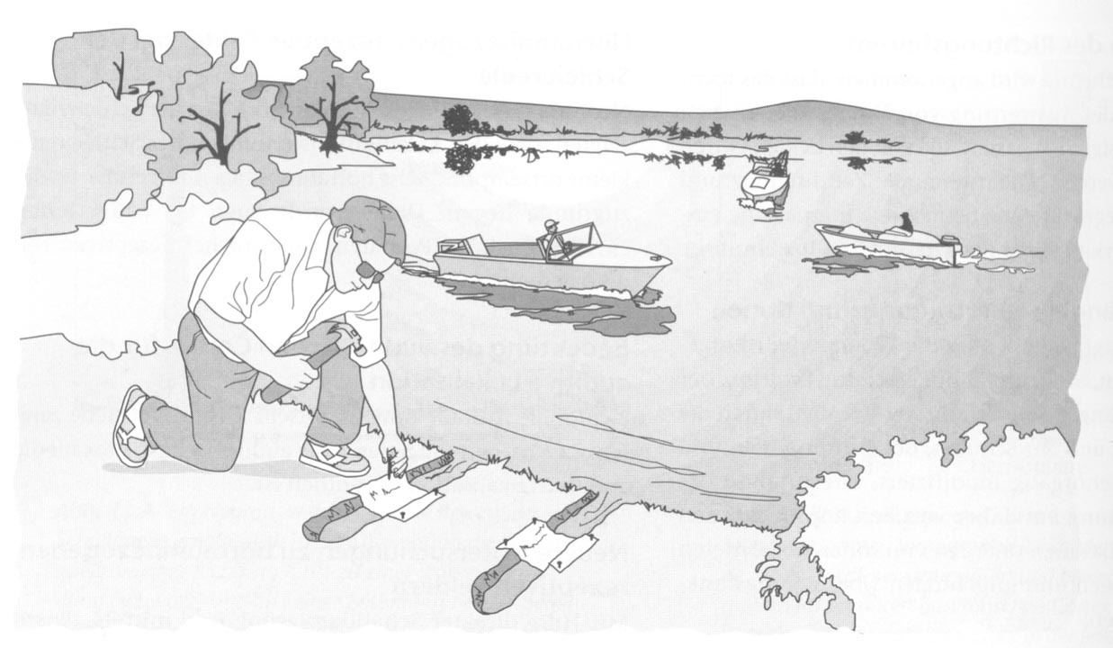
The Current Fitting Paradigm

Slide 9
The Current Fitting Paradigm

Slide 10
Questions
How does scaled hearing care look like?
How do we address inclusive hearing care?
How should we innovate a highly regulated industry?

Slide 11
A Personalized Hearing Health Care Paradigm

Slide 12
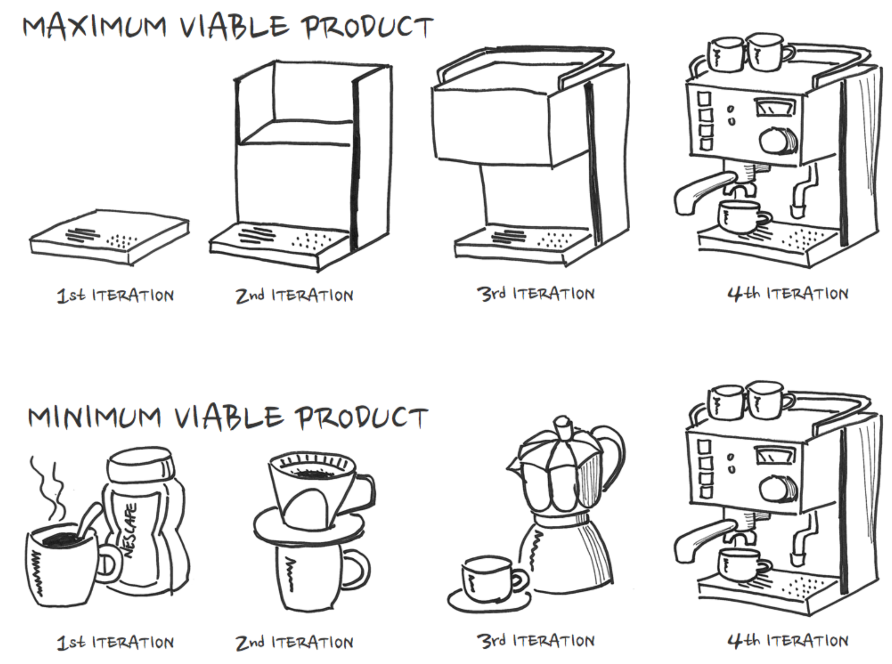
Data Driven UX in Hearing Health Care

Slide 13
Context in Hearing Aids

Slide 14
Context in Hearing Aids

Slide 15
Context in Hearing Aids

Slide 16
User Feedback

Slide 17
Context in Hearing Aids

Slide 18
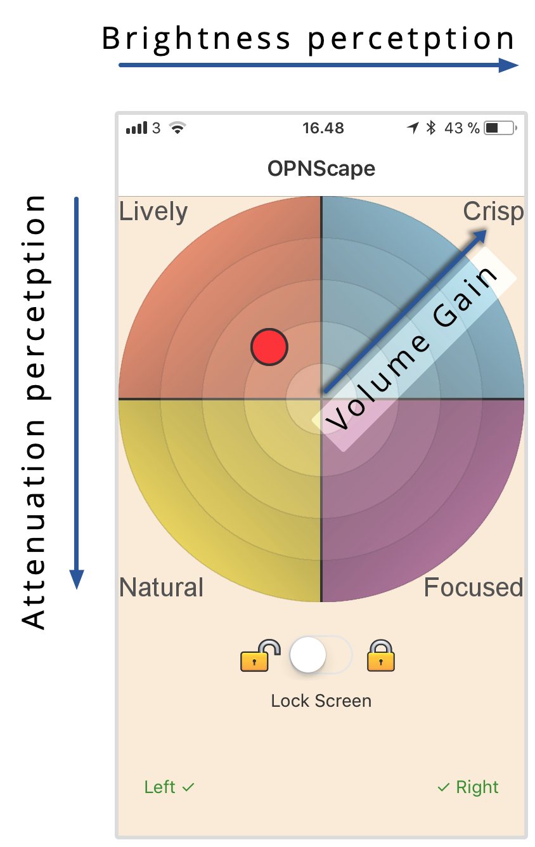
User Feedback

Slide 19
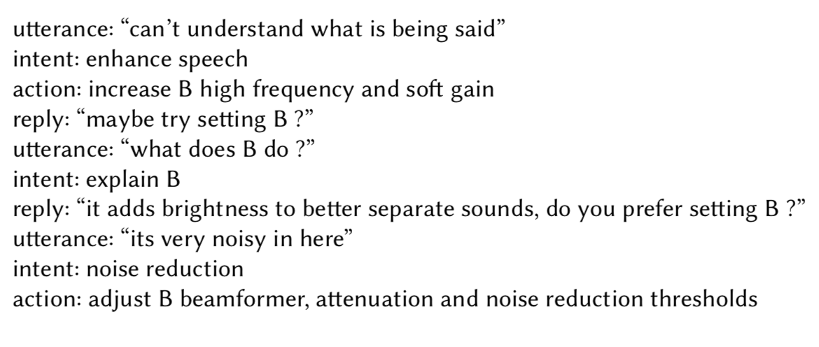
Adaptive Interfaces

Slide 20
Adaptive Interfaces

Slide 21
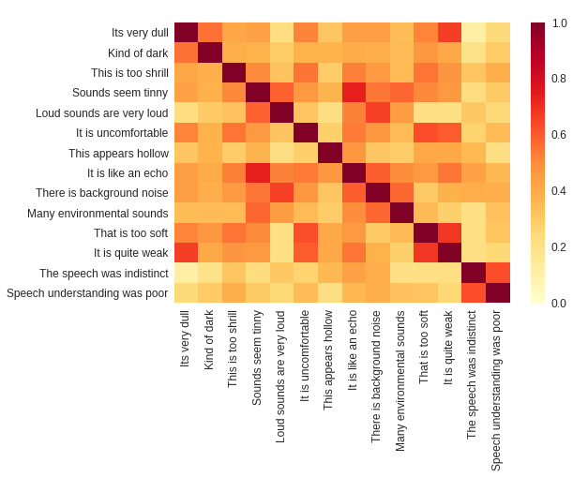
Adaptive Interfaces

Slide 23
Acknowledgement
Michael Kai Petersen, PhD
Maciej Jan Korzepa, MSc Eng.
Niels Henrik Pontoppidan, PhD
Jakob Eg Larsen, PhD
Benjamin.Johansen@paconsulting.com
@benjohresearch

