Slide 1
User engagement – the importance of purpose
Filip Marchman Rønne
27-05-2019

Slide 2


Who am I?
Widex + Sivantos = WS Audiology
  As of March 1st 2019
We produce
  Hearing aids
  Fitting softwares
  Apps
  Assisting devices (e.g. TV streamer, remote microphone, charger)
R&D sites
  Denmark, Germany, Singapore
  India, Sweden, Macedonia
Filip Marchman Rønne
MSc.E.E + PhD in psychoacoustics (Torsten Dau’s lab).
10 years in industry
Last two years as Director Audiology.
  All kind of user tests, mainly applying scientific methods.
  Audiological Research
  System verification and test
Now head of Scientific Audiology
  Collaborations with academia
  Internal research

Slide 3
The widex team context
Features and algorithm development
External test team
Applied Research team
- Studies including test participants
Hearing aid development
Marketing and management

Slide 4
Take away message
Why?
How?
What?

Slide 5


Why ask the user?
It is a hassle!
Takes up a lot of resources.
Answers do always arrive too late.
Answers are rarely black or white, more often greyish.
For the insights gained, the improved products and services, and the better stories to tell.
User experience design
Idea generation
Guiding development
Assisting decision makers
Bug identification
Early concept trials
Claim and evidence
For regulatory purposes
US (FDA), EU, Australia, Korea, Japan, Brazil etc. requires it.
Safety and effectiveness.

Slide 6
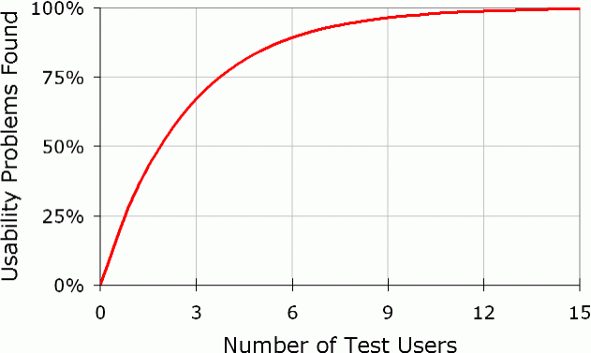
Widex test usage
https://www.nngroup.com/articles/why-you-only-need-to-test-with-5-users/
Guiding development
Assisting decision makers
Early concept trials
Claim and evidence
User experience design
Bug identification
Idea generation
10-100 participants
3+3+3+15 participants
5-7 participants
>1 participants

Slide 7
Widex test usage
Guiding development
Assisting decision makers
Early concept trials
Claim and evidence
User experience design
Bug identification
Idea generation
10-100 participants
3+3+3+15 participants
5-7 participants
>1 participants

Slide 8
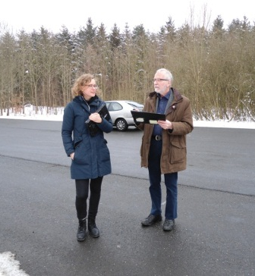
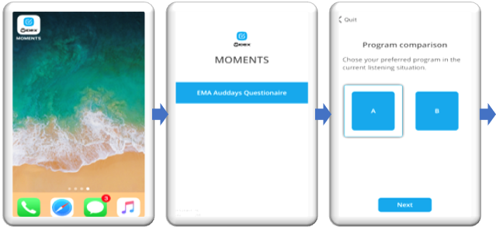

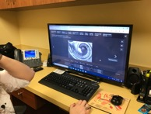

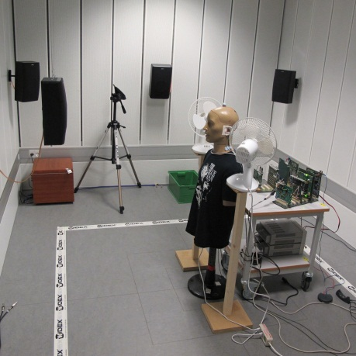
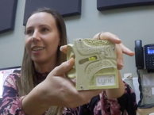

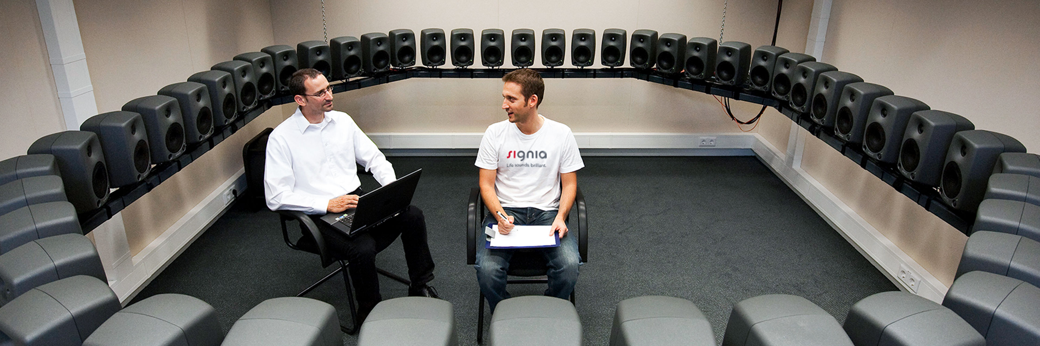
Data collection in widex
Field trials
Ecological Momentary Assessment
Anthropological studies
Lab tests
Interviews

Slide 9
Process when conducting an experiment
Purpose and main research questions

Slide 10
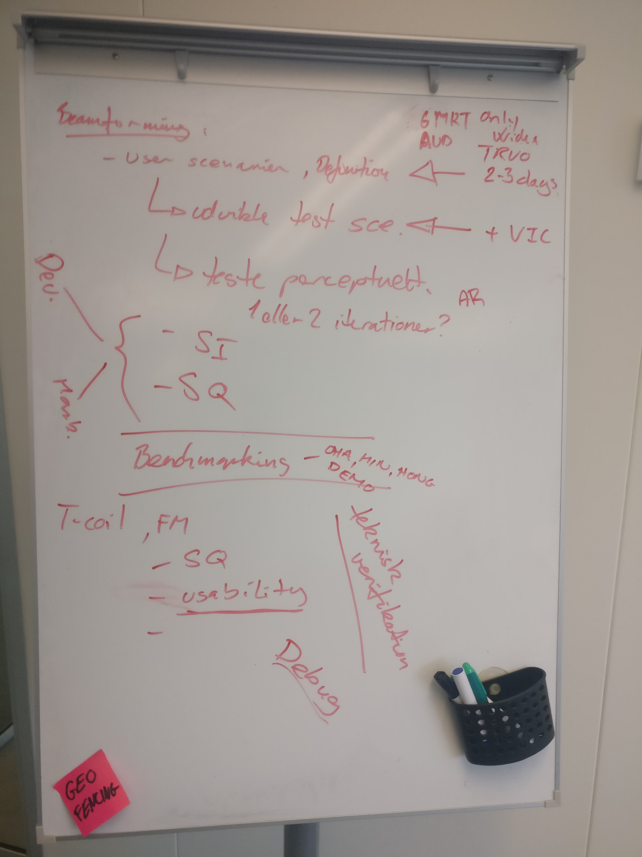
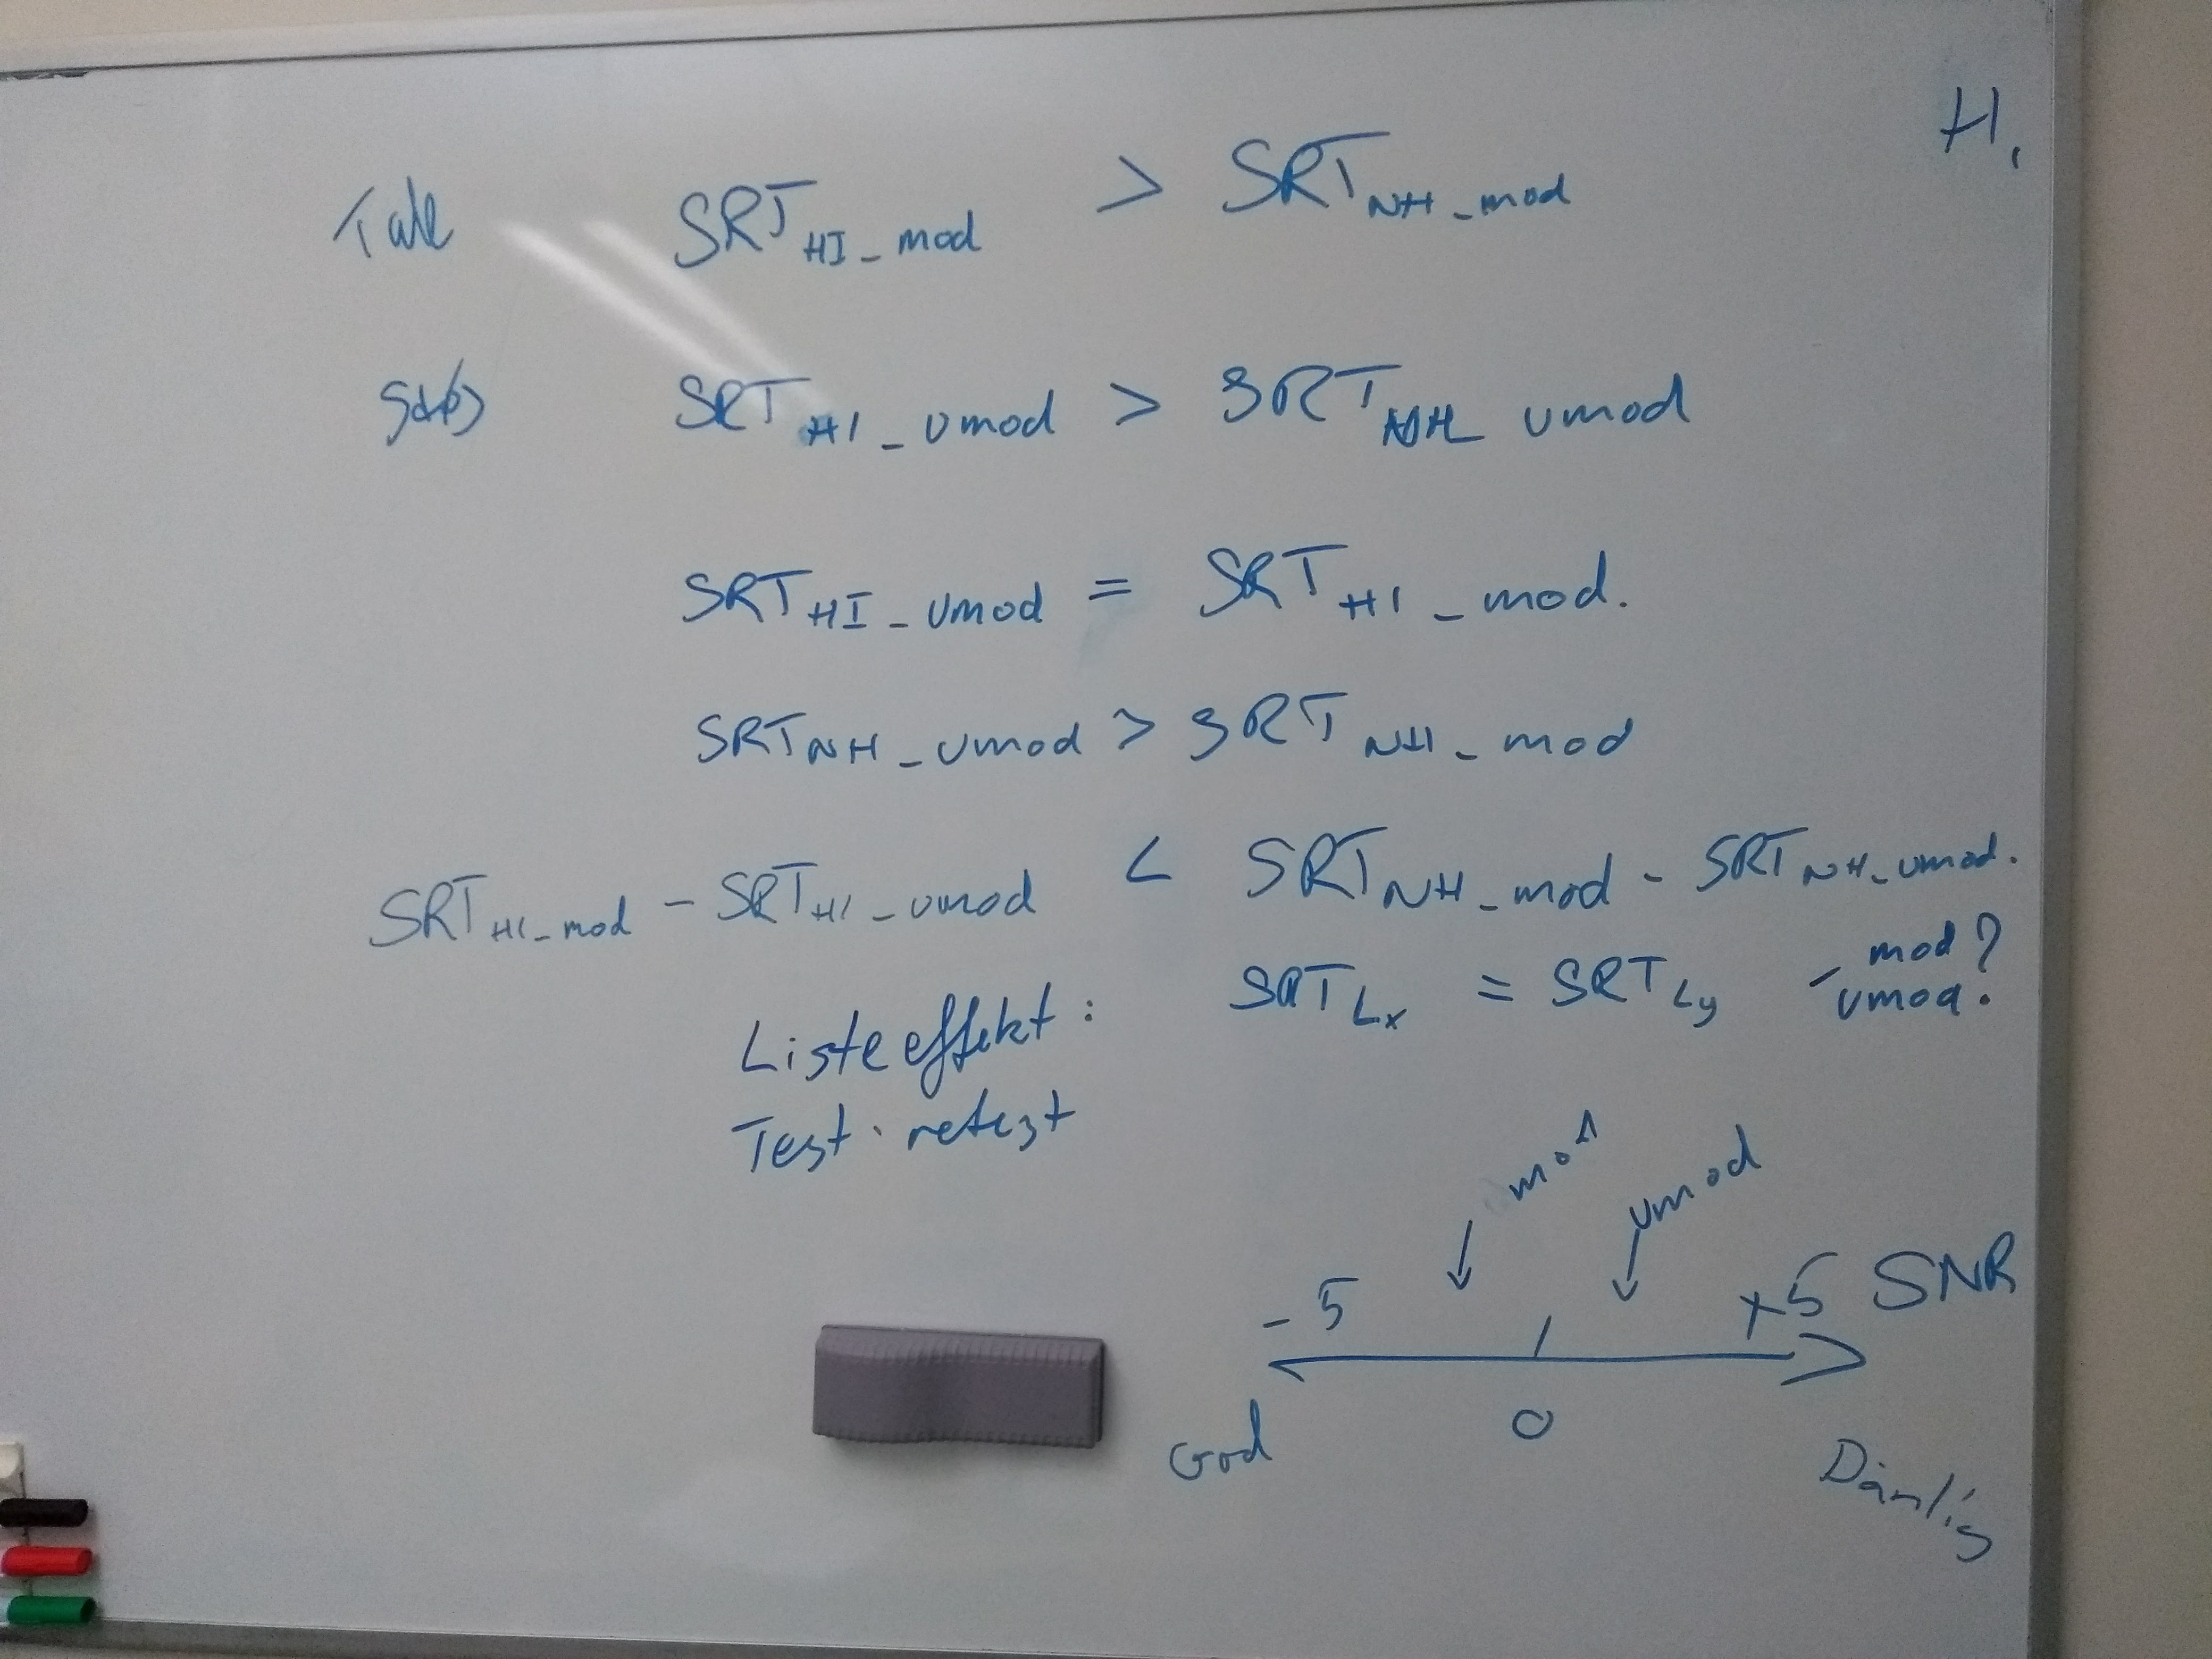
Process when conducting an experiment
Purpose and main research questions
Facilitated discussion with requestors on:
All possible purposes
As many research questions as possible
Outcomes
Agree on one main purpose addressed by a few research questions.
Prioritized list of remaining questions.
Visualize at meeting

Slide 11
Process when conducting an experiment
Purpose and main research questions
Draft a presentation on method
Protocol meeting with stakeholders

Slide 12
Process when conducting an experiment
Agree / approve following:
Final list of research questions
Outcome measures
Success criteria
Protocol meeting with stakeholders
Visualize at meeting

Slide 13
Process when conducting an experiment
Purpose and main research questions
Draft a presentation on method
Protocol meeting with stakeholders
Write protocol
Review protocol amongst experts
Risk analysis
Test setup
Recruitment

Slide 14
Process when conducting an experiment
If experimental by nature remember Good Clinical Practice (GCP)
Remember recruitment takes time, it is cumbersome.
Protocol meeting with stakeholders
Write protocol
Risk analysis
Test setup
Recruitment

Slide 15
Process when conducting an experiment
Purpose and main research questions
Draft a presentation on method
Protocol meeting with stakeholders
Write protocol
Review protocol amongst experts
Risk analysis
Test setup
Recruitment
Conduct study
Data analysis
Study report
Report out meeting

Slide 16
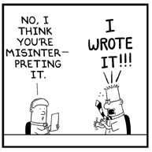
Process when conducting an experiment
Gather stakeholders
Present and discuss results
Discuss conclusions and implications
Agree on wording of conclusion!
However, do not take project decisions at this meeting!
The purpose here is to agree on what the results show. This is the foundation for possible later meetings where project decisions can be made.
Purpose and main research questions
Draft a presentation on method
Protocol meeting with stakeholders
Review protocol amongst experts
Risk analysis
Test setup
Recruitment
Conduct study
Data analysis
Study report
Report out meeting
Remember to focus on the results and what they imply.

Slide 17
Process when conducting an experiment
Purpose and main research questions
Draft a presentation on method
Protocol meeting with stakeholders
Write protocol
Review protocol amongst experts
Risk analysis
Test setup
Recruitment
Conduct study
Data analysis
Study report
Report out meeting

Slide 18
Pitfalls – where do we fail (@ Widex)?
Purpose and main research questions
Draft a presentation on method
Protocol meeting with stakeholders
Write protocol
Review protocol amongst experts
Risk analysis
Test setup
Recruitment
Conduct study
Data analysis
Study report
Report out meeting

Slide 19
Pitfalls – where do we fail (@ Widex)?
Purpose and main research questions
We forget to ask the key question to the purpose:
What is the consequence of the different possible results?
  Positive → then what?
  Negative → then what?
  Greyish → then what?
  If answer is the same, why do the study?

Slide 20
Pitfalls – where do we fail (@ Widex)?
Purpose and main research questions
Draft a presentation on method
Protocol meeting with stakeholders
Write protocol
Review protocol amongst experts
Risk analysis
Test setup
Recruitment
Conduct study
Data analysis
Study report
Report out meeting

Slide 21
Pitfalls – where do we fail (@ Widex)?
Statistical power, under sampling
Representative user segments
  FDA: Use 15 people from each user segment for usability work.
White people in early twenties with above average cognitive abilities … i.e. University students.
White people in early seventies with above average cognitive abilities and limited geriatric problems
… i.e. retired Engineers from Nordsjælland.
Risk analysis
Test setup
Recruitment

Slide 22
Pitfalls – where do we fail (@ Widex)?
Statistical power, under sampling
Representative user segments
  FDA: Use 15 people from each user segment for usability work.
Risk analysis
Test setup
Recruitment
Hearing Care Professionals
Educational level
Cultural background
Working culture
Office space
HA users
Age
Hearing loss
Cognitive ability
Cultural background
Language

Slide 23
Pitfalls – where do we fail (@ Widex)?
Purpose and main research questions
Draft a presentation on method
Protocol meeting with stakeholders
Write protocol
Review protocol amongst experts
Risk analysis
Test setup
Recruitment
Conduct study
Data analysis
Study report
Report out meeting

Slide 24
Pitfalls – where do we fail (@ Widex)?
We fail to acknowledge or describe how generalizable the results are?
And / or we fail to describe what the perspectives could be.
You cannot conclude based on data from 10 test participants that A is better than B for all people in this world.
Be bold on the perspectives. You will never have data to support a general claim that A is better than B for the world population. And you will never go anywhere if you do not make assumptions and move on.
Study report
Report out meeting

Slide 25
Practicalities and examples
Recruitment advertisement
  Local patient magazines (“Hørelsen”)
  Local news paper (“Allerødnyt”)
  Relevant facebook groups (with permission of course)
Rewards for participation
  We do not pay our test participants as this would clearly violate the Declaration of Helsinki, and the risk the validity of the data collected.
  We reimburse travel expenses, and offer a one-time discount in out hearing aid shop.
Data handling
  Signed informed consent on everything, including data from internal test participants.
  All data anonymized and backed up.
  Project data cannot be deleted as the Medical Device Regulation prevails GDPR, thus data has to be stored for a number of years.

Slide 26
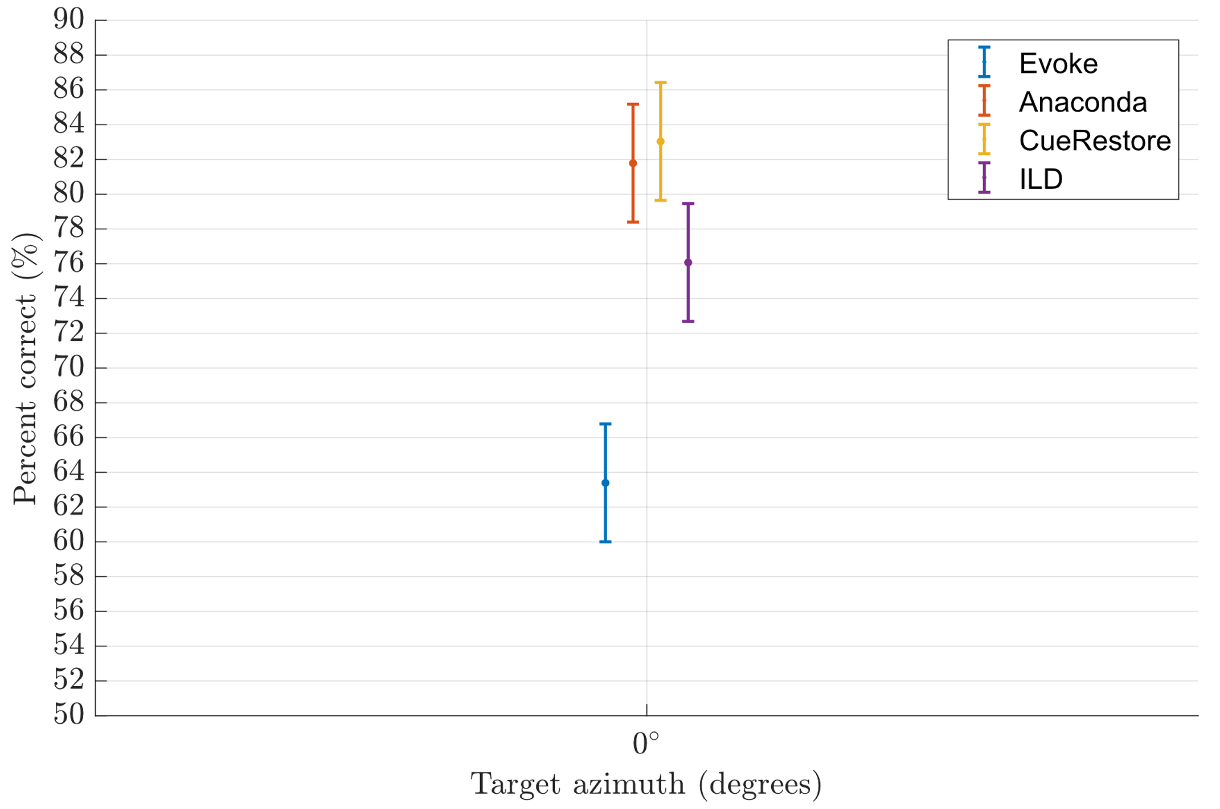
interfering talkers

Slide 27
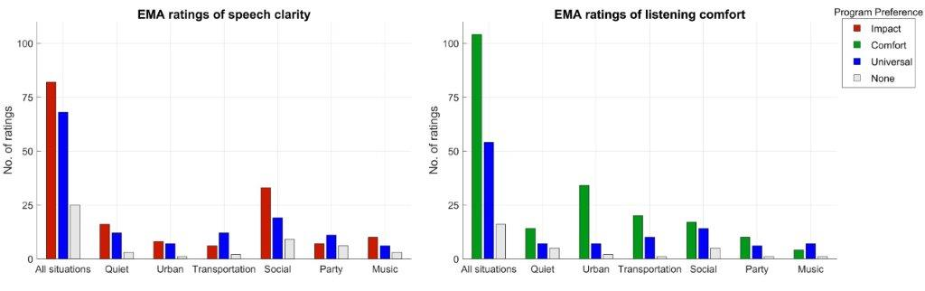
Ecological Momentary assessment

Slide 28
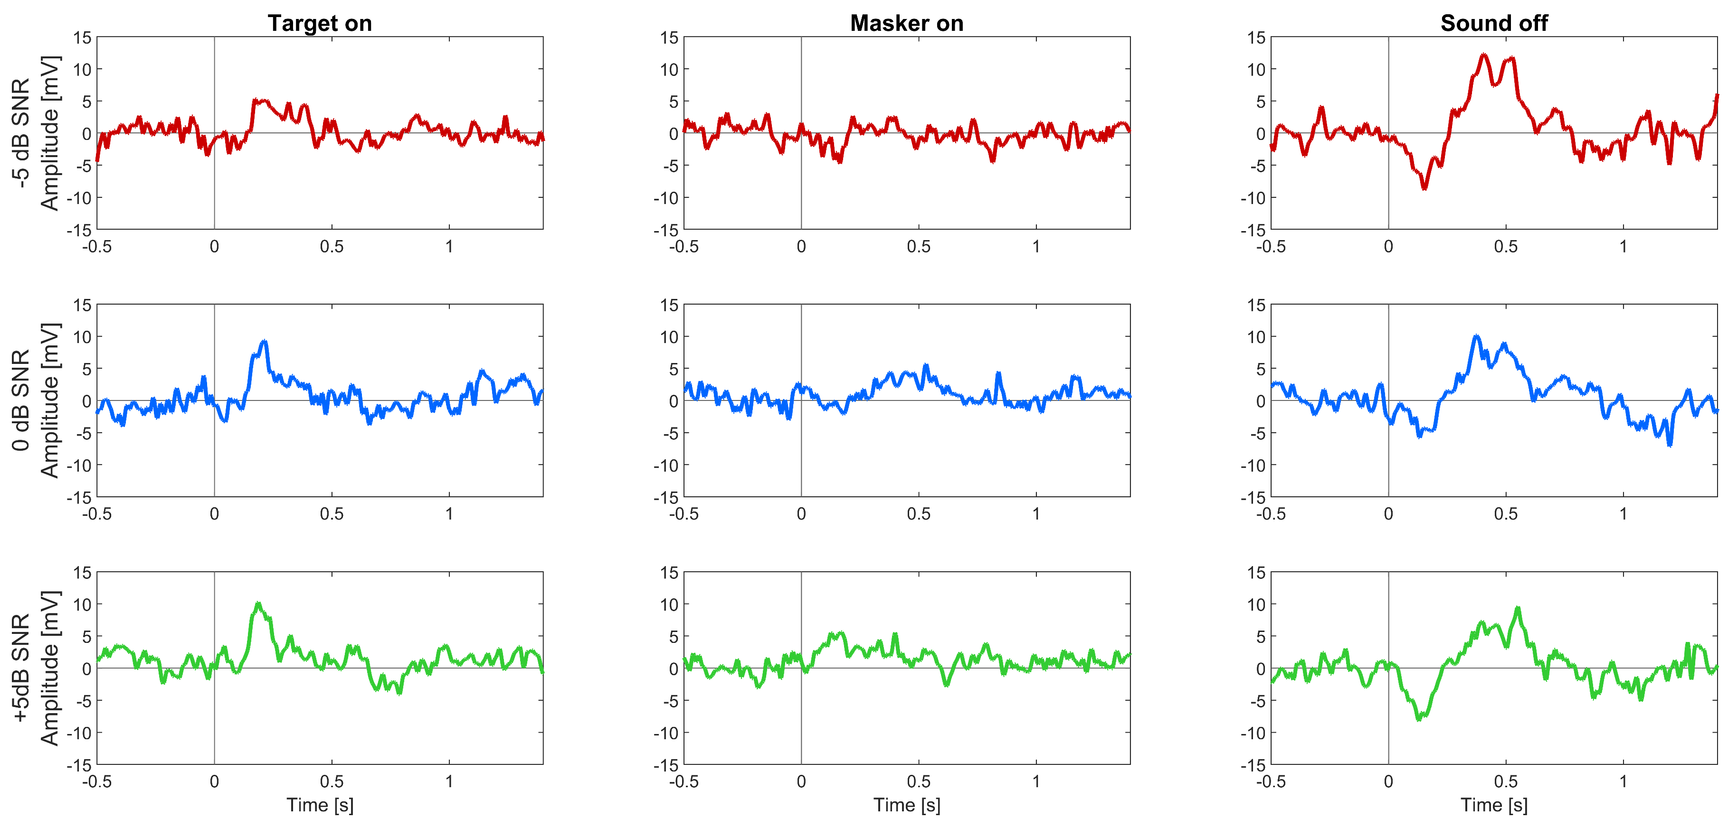
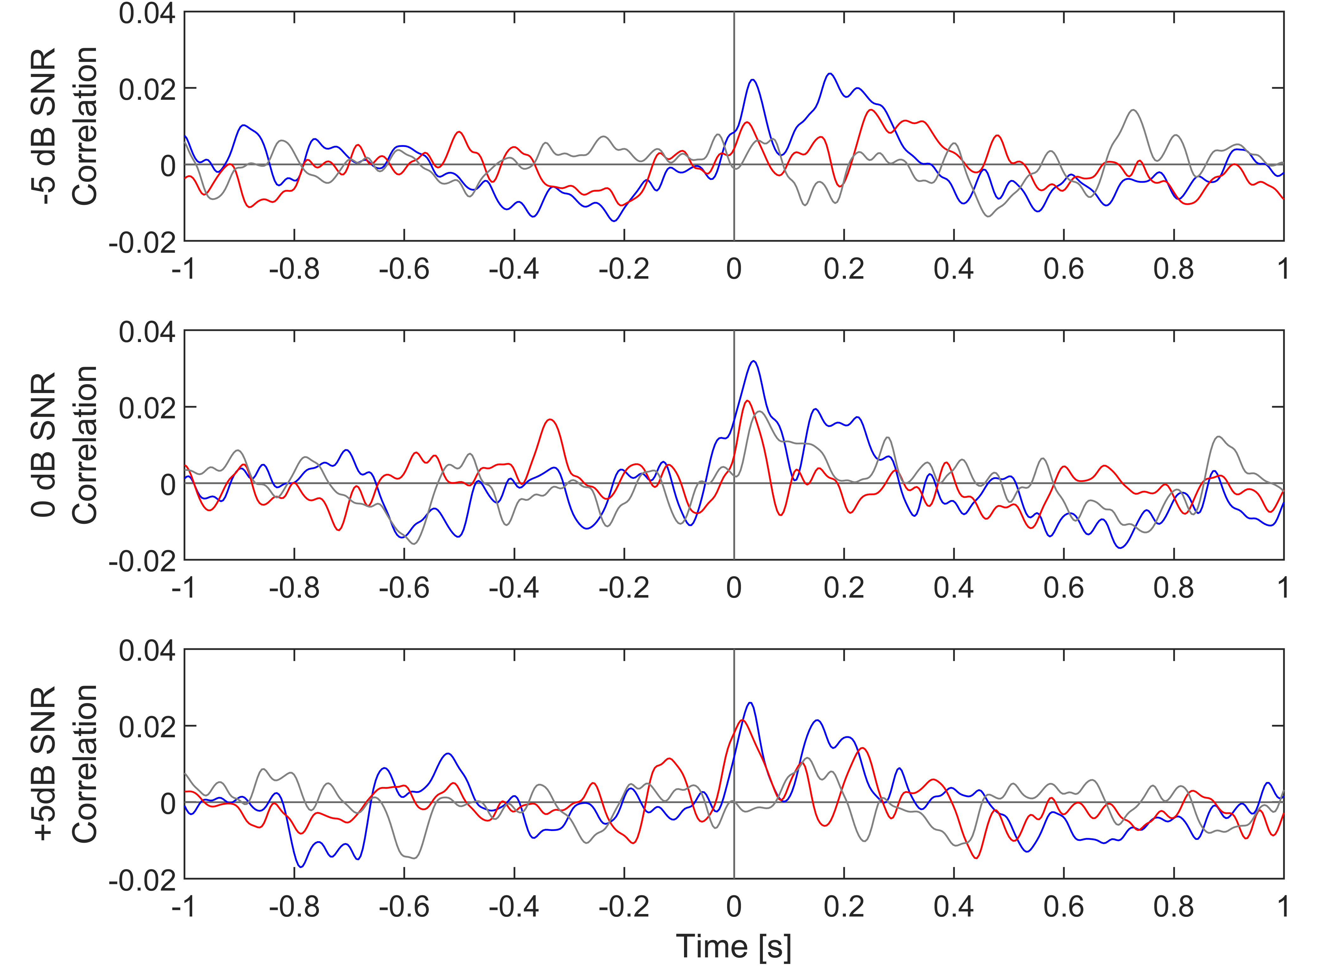

EEG based cognitive load measure
Time | 2 s | 3-4 s | 60 s |  |  | 1-3 s | x 3 SNRs x 15 trials
Screen | ‘The man’ | + | + | What was the name of the dog? Press 1: Fido Press 2: Rex Press 3: Pluto | When did he last see the dog? Press 1: Monday Press 2: Sunday Press 3: Wednesday | +
Sound
Keyboard |  |  |  | 1-2-3 | 1-2-3

Slide 29




Anthropological study – outcome example
And even if the motives differ amongst audiologists and dispensers, they both need to sell in order to sustain a healthy business
MOTIVATION:
I am in it for the counselling and I don’t like to feel like a sales person.
COUNSELLING
MOTIVATION:
I am in it to sell devices and I dislike spending too much time counselling.
SELLING
AUDIOLOGIST
DISPENSER
“We spend a bunch of money (on school) to not be compensated as we should, but that’s because its not about money… we want to provide them something that they’re going to love, that will change their lives”
SJ, Los Angeles
“I will provide them with a device that matches their expectations, I will not try to go above and beyond with sound quality, I’ll fix the bads and don’t worry about the goods”
Arjun, Orlando
“When I first started selling hearing aids I learned that I had to do counselling.”
Meg, Tokyo

Slide 30
Summary and advises
Engage users in development?
  Yes! Please do so. But consider carefully why you are doing it?
Involve your peers to challenge you on your test design.
  And keep your stake holders happy.
Take your results seriously
  What do you do if the results come negatively? Prepare for the different outcomes.
Be objective about what the results show, and acknowledge the limits of how your data can be generalized.
  But be bold on perspectives.
… and be prepared to be surprised. This is where you truly learn something!

Slide 31
User engagement – the importance of purpose
Filip Marchman Rønne
22-05-2019

